Slide 1
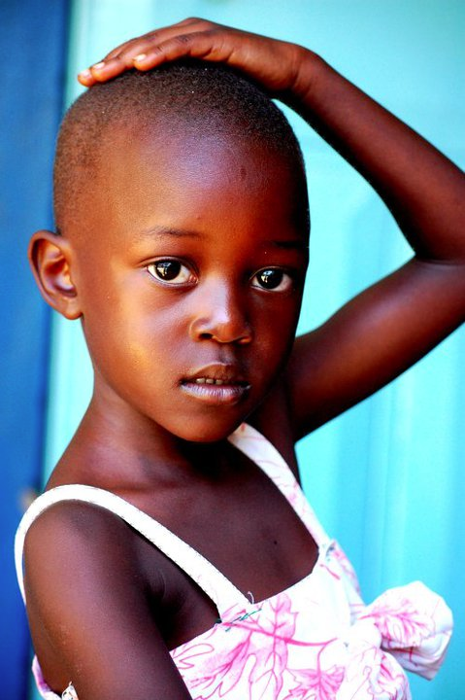


Slide 2
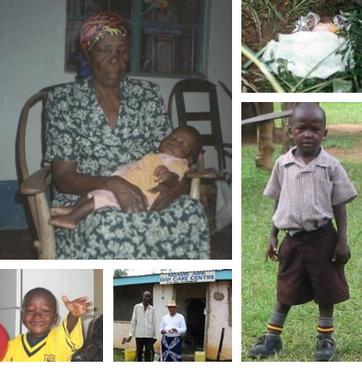
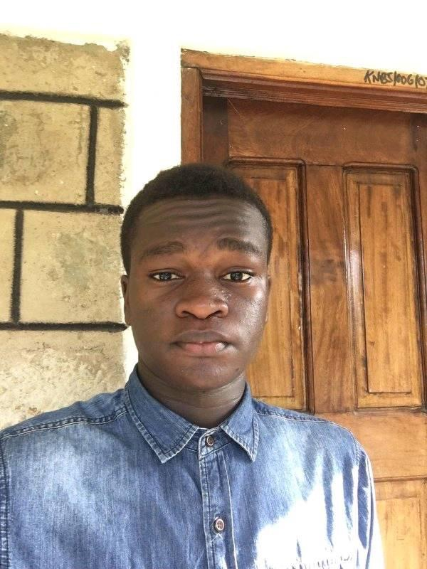
The Nasio Story

Slide 3
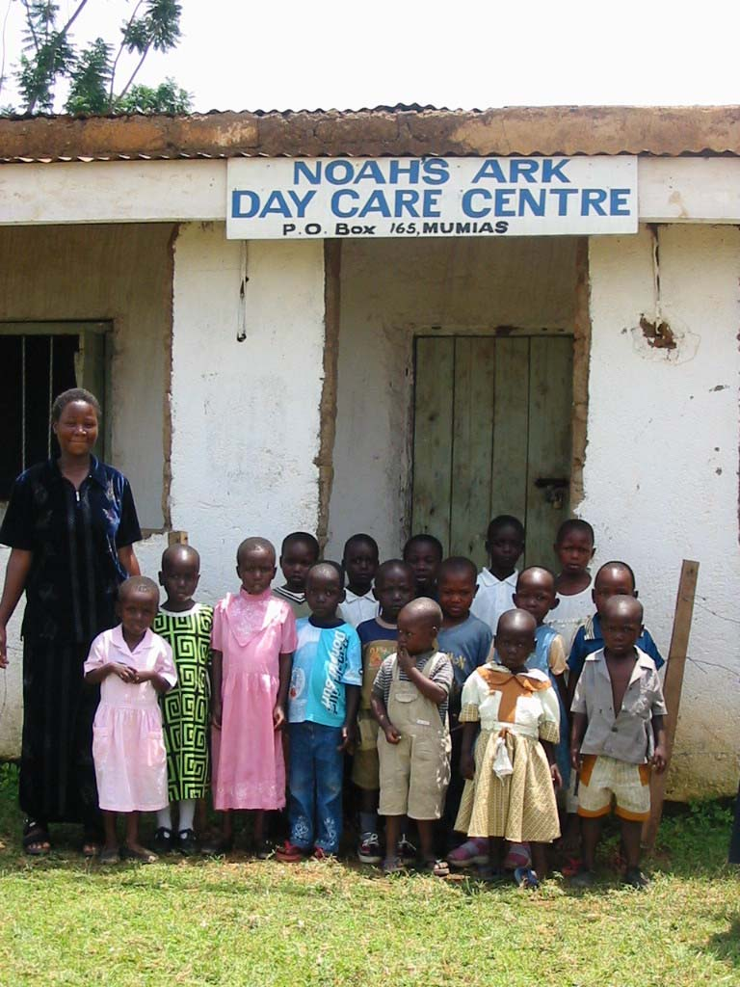
First 15 students

Slide 4
Noah’s Ark Day Care Centre

Slide 5
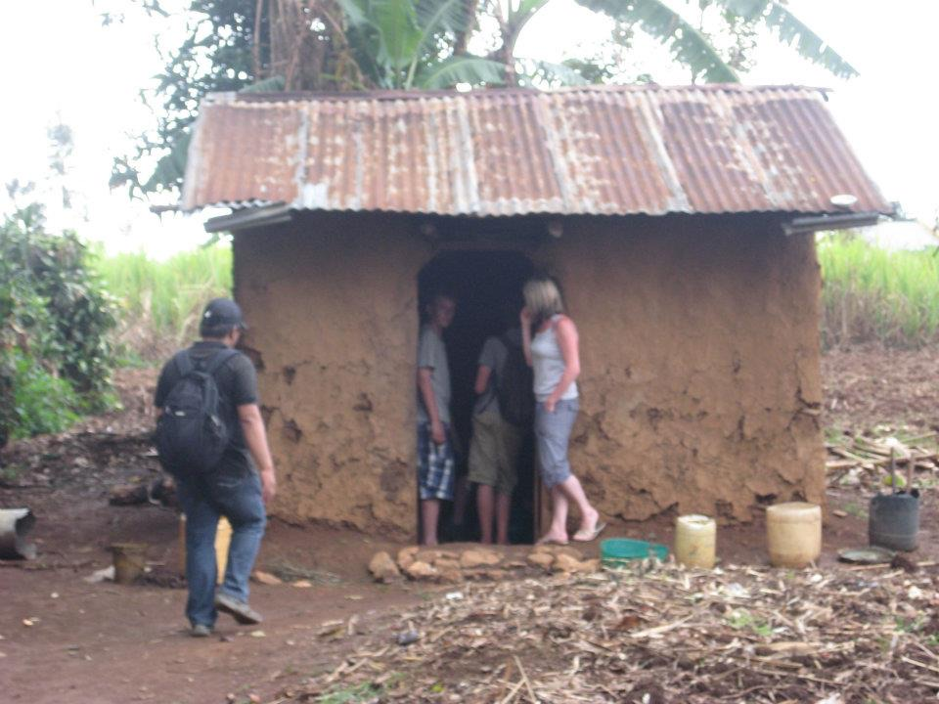
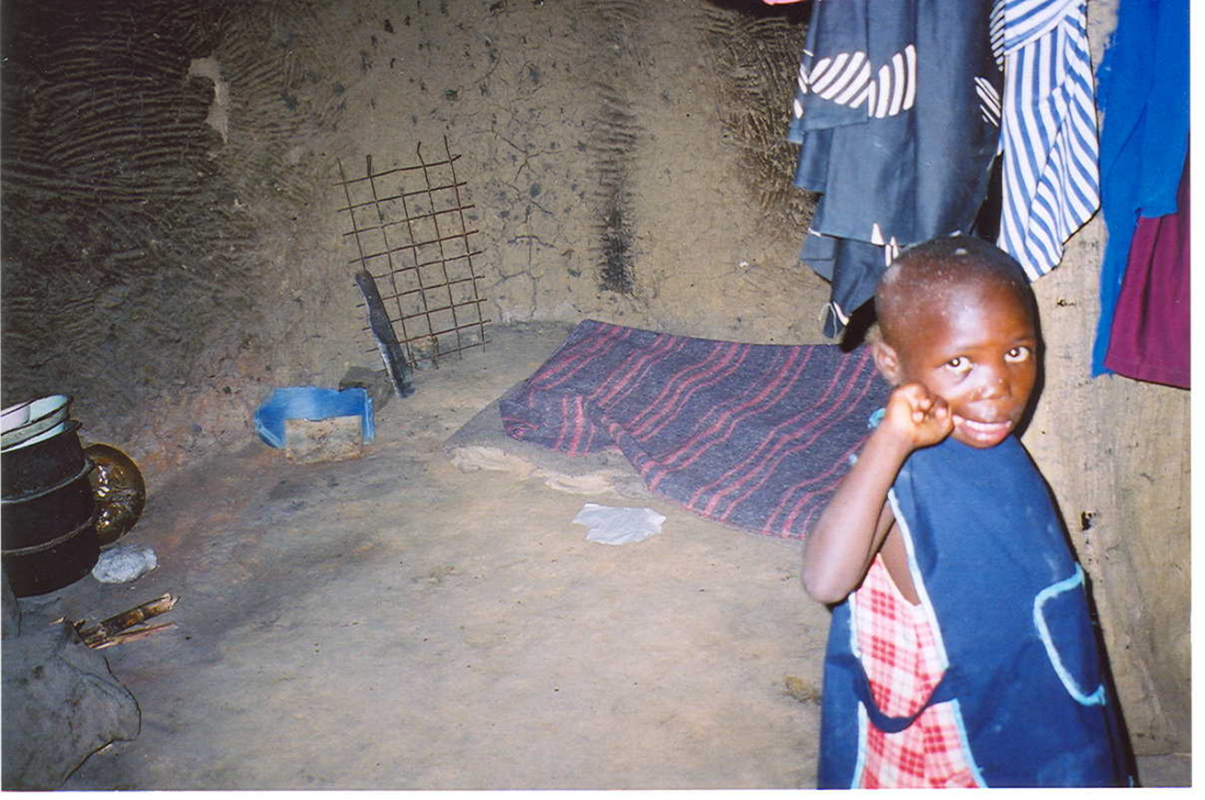
Home Visit
*Sponsored by*
*pre-prep*

Slide 6
Jambo Song
Jambo
(Hi)
Jambo bwana
(Hi sir)
*Sponsored by*
*pre-prep*

Slide 7
Jambo Song
Habari gani
(How are you?)
Mzuri sana
(Very fine)
*Sponsored by*
*pre-prep*

Slide 8
Jambo Song
Wageni mwakaribishwa
(Visitors are welcome)
Kenya yetu
(Our country Kenya)
Hakuna Matata
(No worries)
*Sponsored by*
*pre-prep*

Slide 9



