Slide 1

Researching Fairtrade Products
Year 5

Slide 2
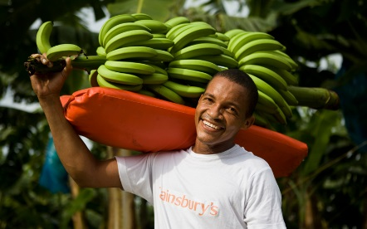

Bananas
One in three bananas bought in the UK are fairtrade. Fairtrade bananas are grown in Latin America, the Caribbean, South Asia and West Africa.

Slide 3
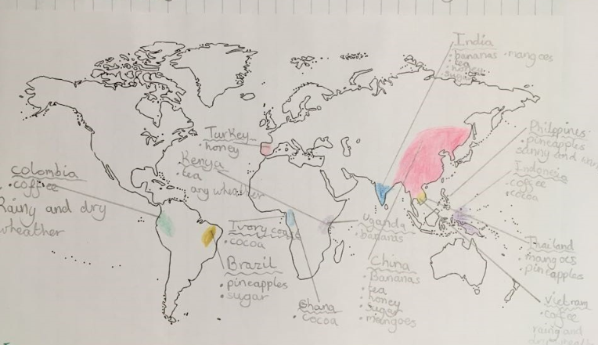
Map showing Fairtrade Countries

Slide 4
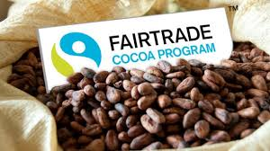
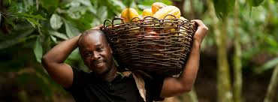
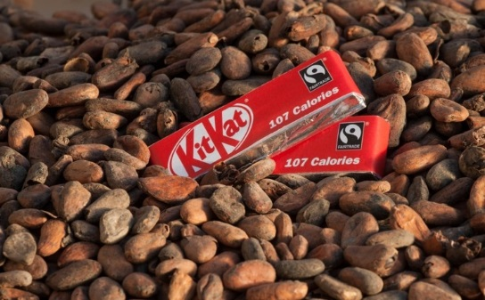
Cocoa and Chocolate
Most farmers have never tasted fairtrade chocolate in their life. They grow the cocoa and it is exported
Over six million globally depend on growing cocoa to feed their family.

Slide 5
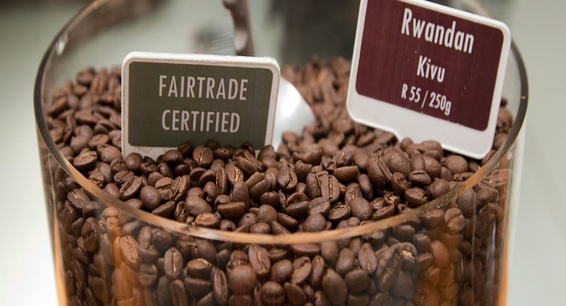

Coffee
Coffee is one of the most popular Fairtrade beverages.
Coffee is grown in Brazil, Vietnam, Columbia and Indonesia

Slide 6
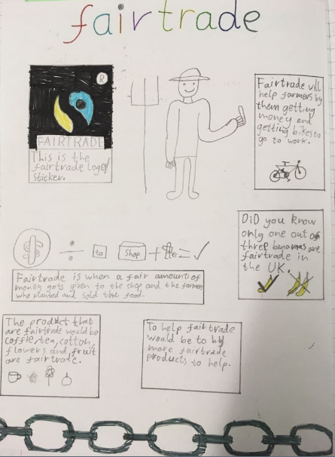

Slide 7
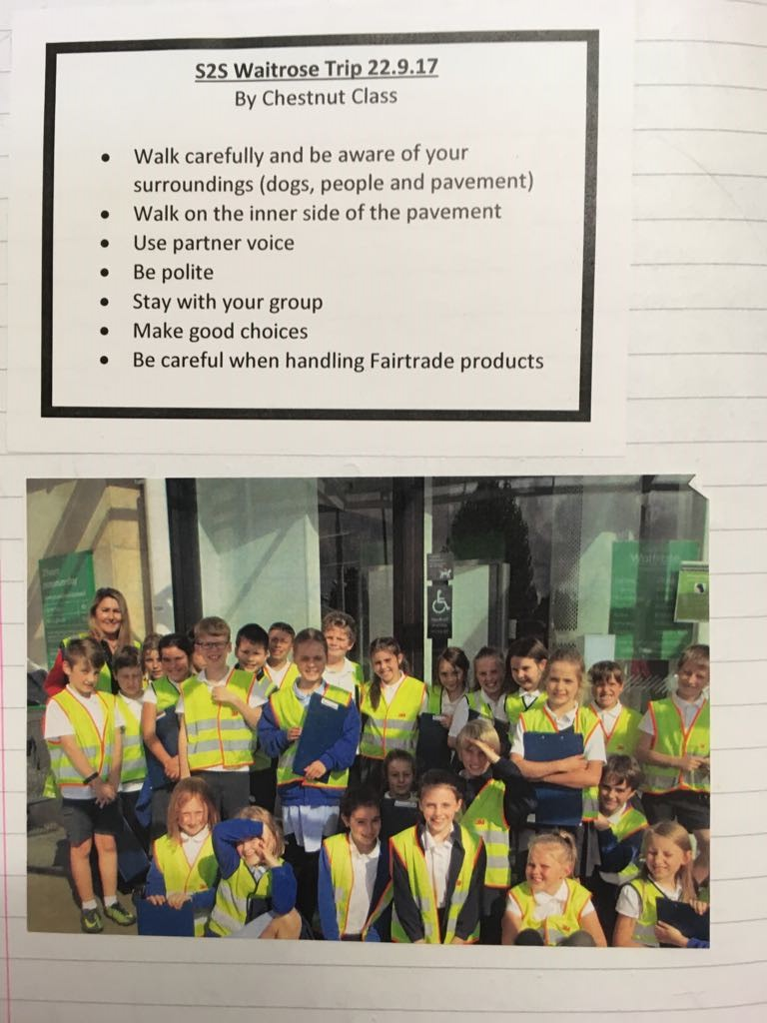
Year 5 class went to Waitrose to learn more about Fairtrade products sold in our shops
We found fruit, chocolate, coffee, pasta and rice
Buy Fairtrade!

Slide 8
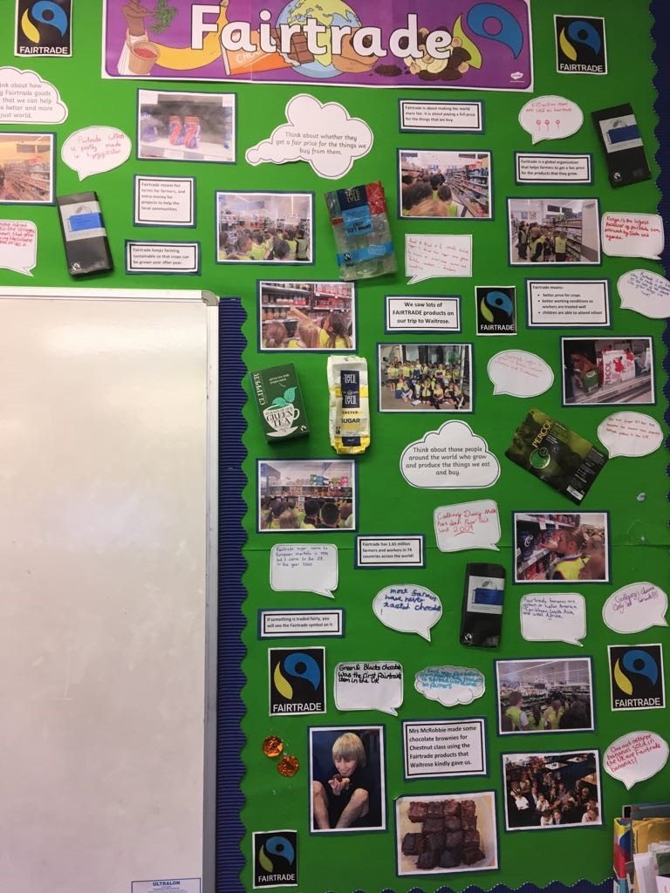
Our display of the work we learnt about Fairtrade

Slide 9
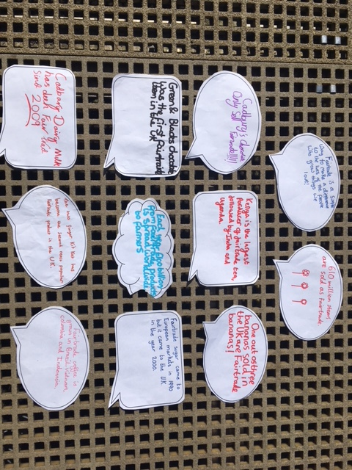
These are some of our learning reflections from our Fairtrade Project

