Slide 1
Chinese Number Games made by
Year 6
We were learning about Ancient China and learning how to count in Chinese. It was really hard but we learnt them in the end. We then had an idea to make some games so we could practice saying the numbers in Chinese.

Slide 2
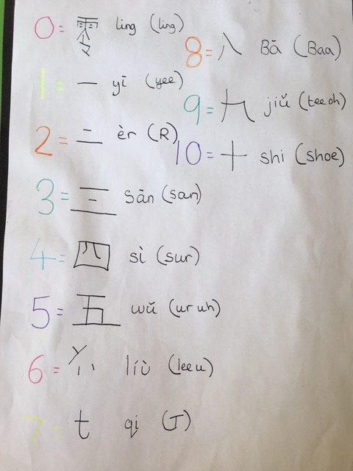
Learning to count in Chinese
The numbers in Chinese were really hard but we learnt them in the end. The trick is to keep practising!

Slide 3
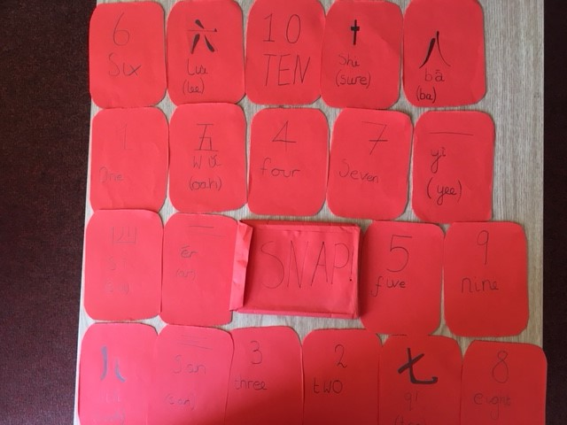
SNAP game in Chinese
Our SNAP game worked!

Slide 4
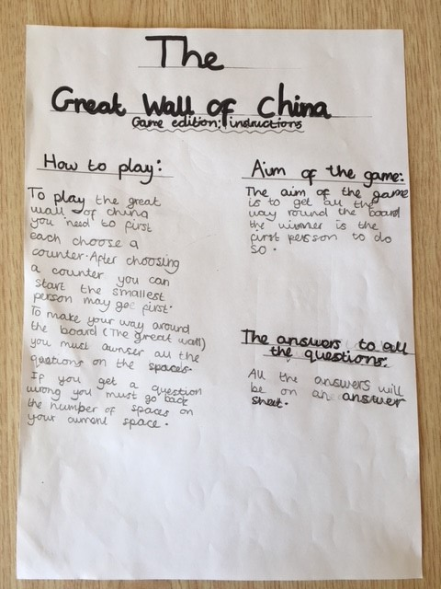
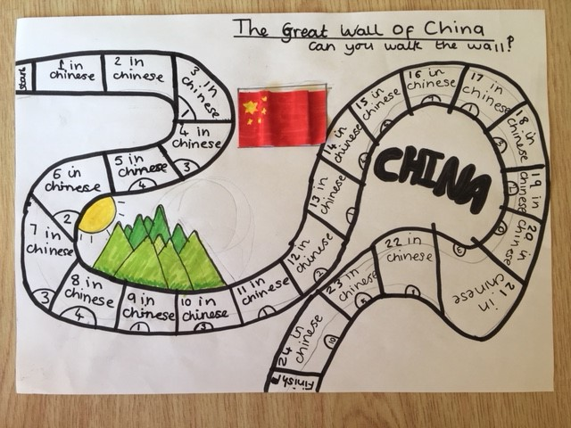
The Great Wall of China board game
Remembering the numbers in Chinese and the facts we learnt

Slide 5
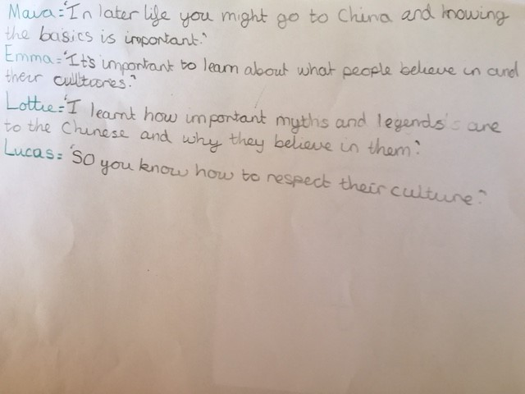
What did you learn about China and why do you think it’s important to learn about other cultures?

Slide 6
What did the Teachers and Parents think
It is very important to learn about other cultures and to have an insight into how people around the world live. (Parent)
The children enjoyed researching facts about China, in particular how to say certain words and numbers. We listened carefully to the numbers being said individually and through songs online and then practised saying them. (Teacher)
Our child came home and enjoyed telling us about the game that she had created at school. We all learnt how to count up to ten playing it – it was good fun. (Parent)

