Slide 1

नमस्ते
Through my Window
by Ash Class
Year 4
Fir Tree Junior School

Slide 2
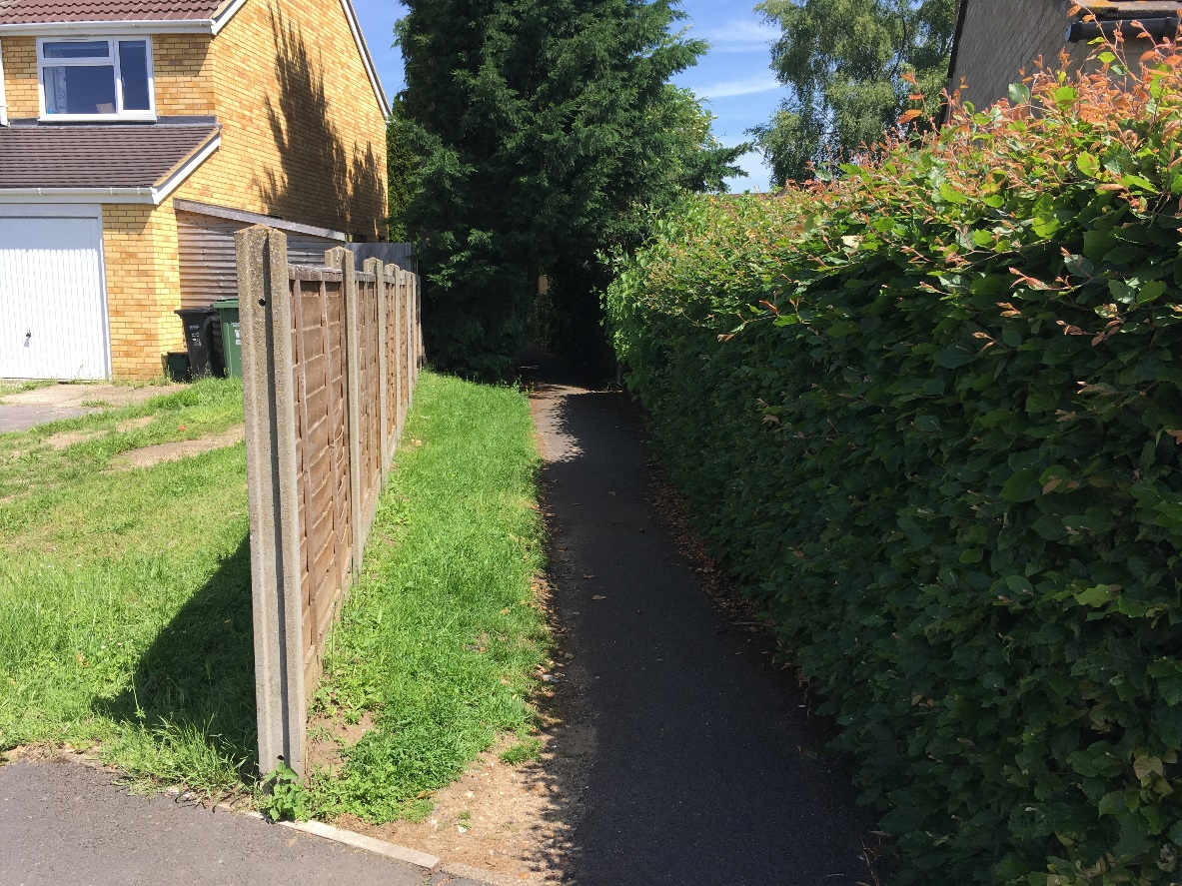
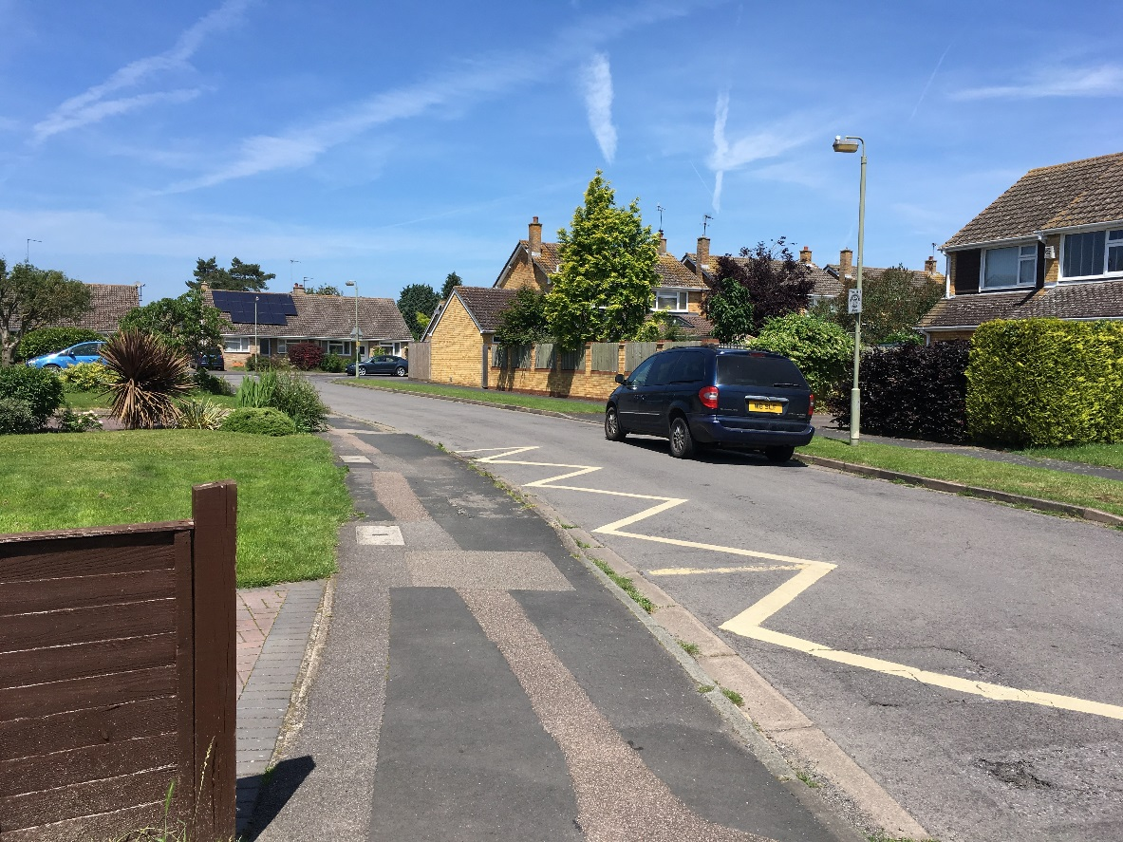
What we see on our way to school – the different paths people take
What do you see on your way to school?

Slide 3
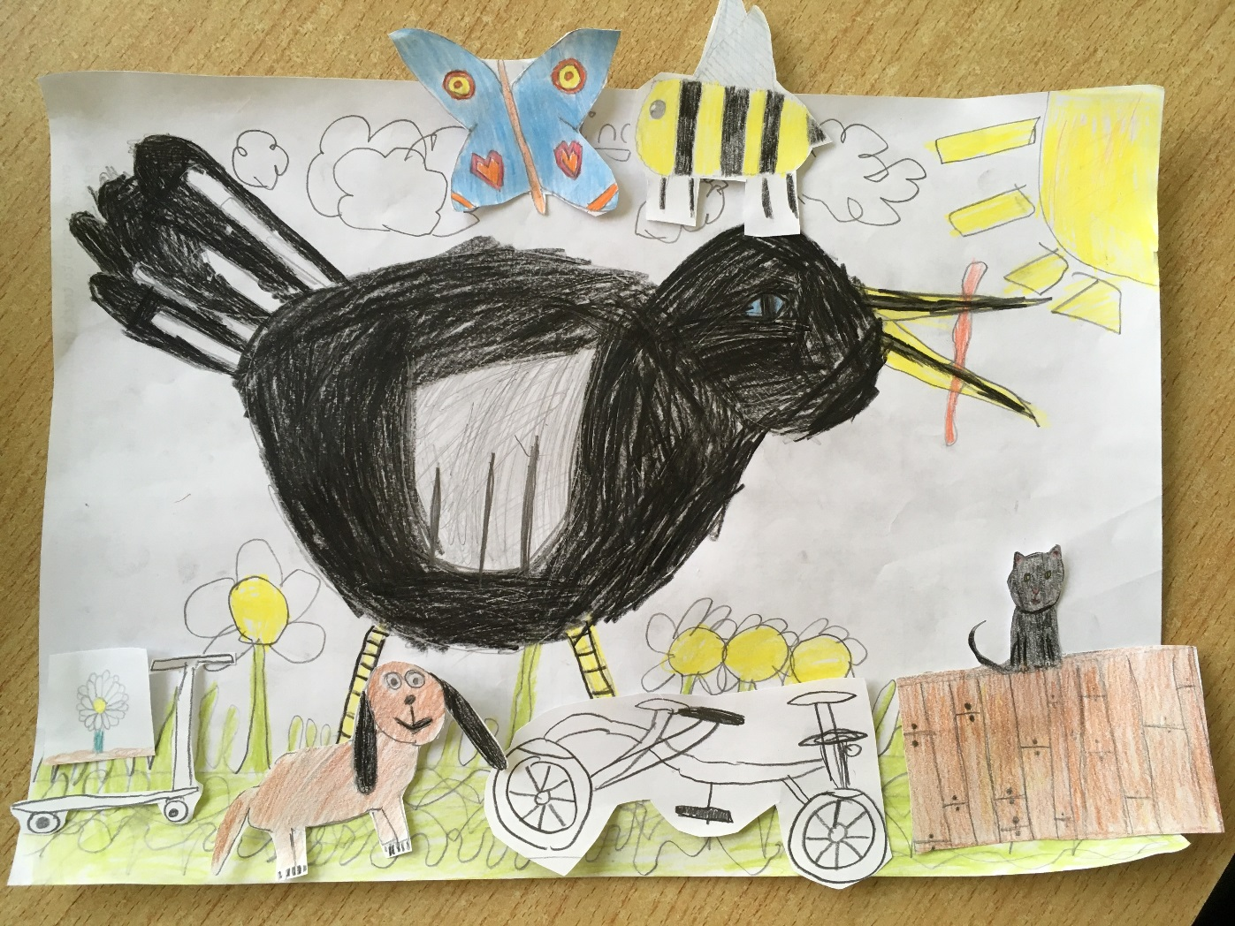
Drawings of things we see on our way to school

Slide 4
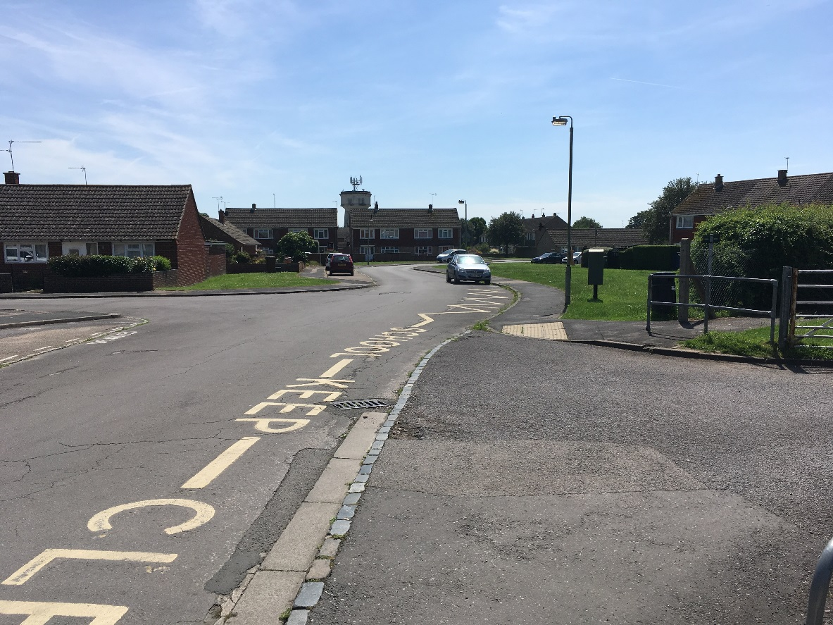
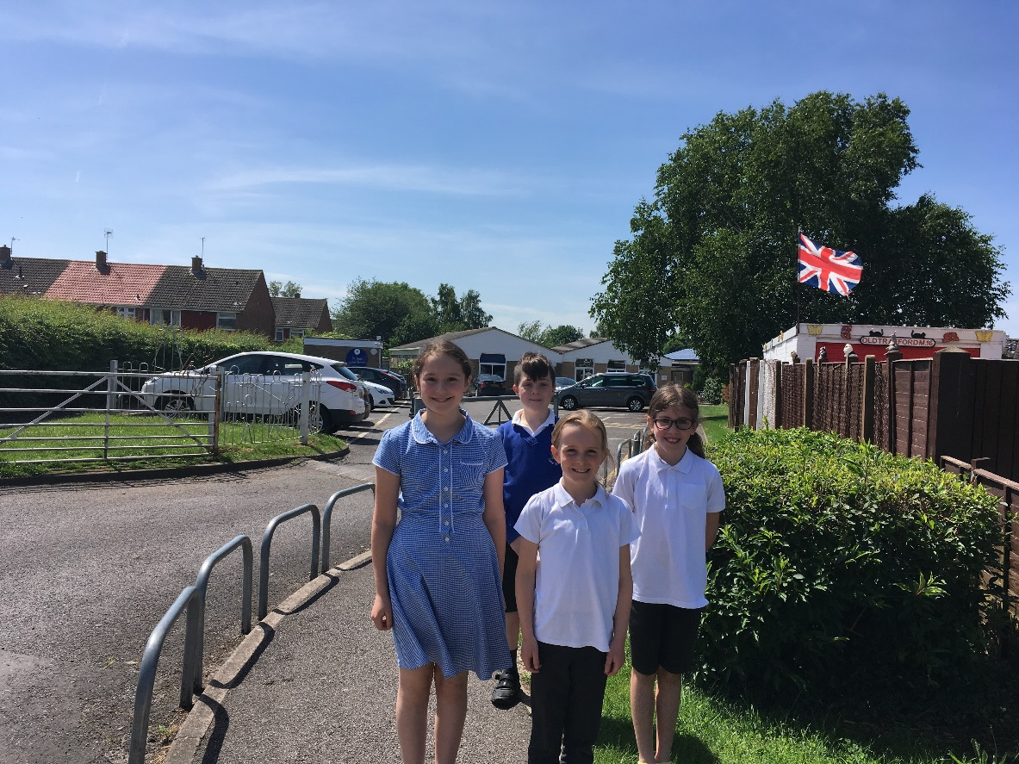
Our school entrance and car park
From the pictures you sent us, our schools are different but we all go to school to learn
We liked your school in the mountains

Slide 5
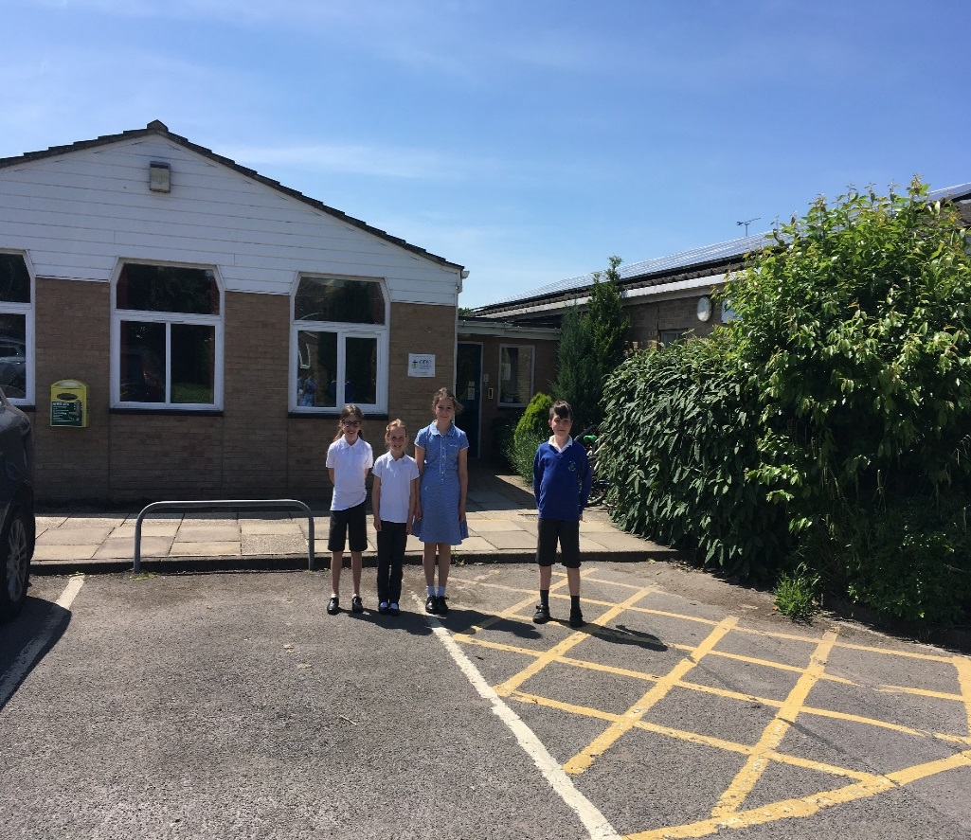
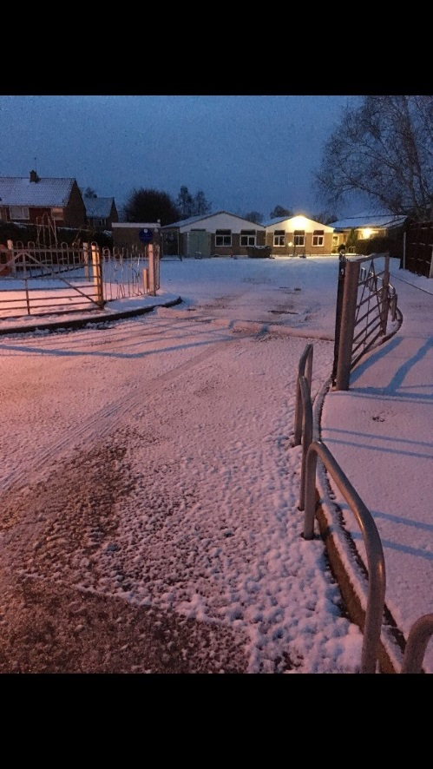
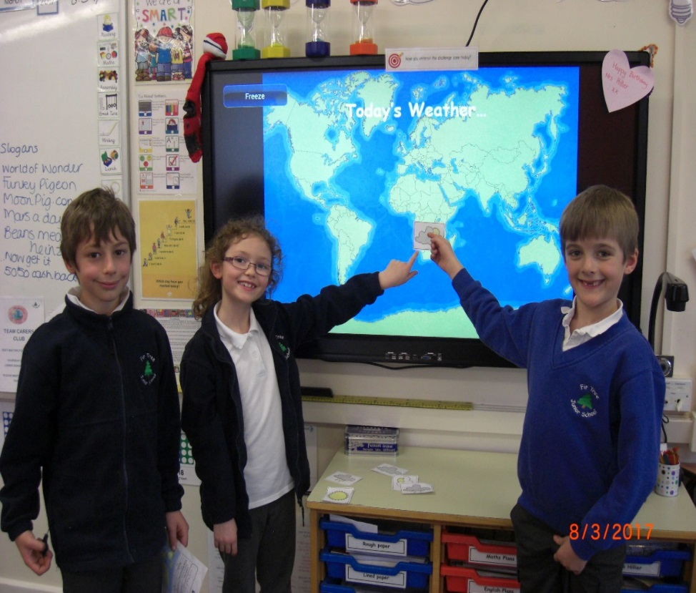
Weather in the UK
School in the sunshine!
School in the snow
We learn all about the weather in
our country and across the world
It can get very hot here and it can
snow too in the winter.
What kind of weather do you have?

Slide 6
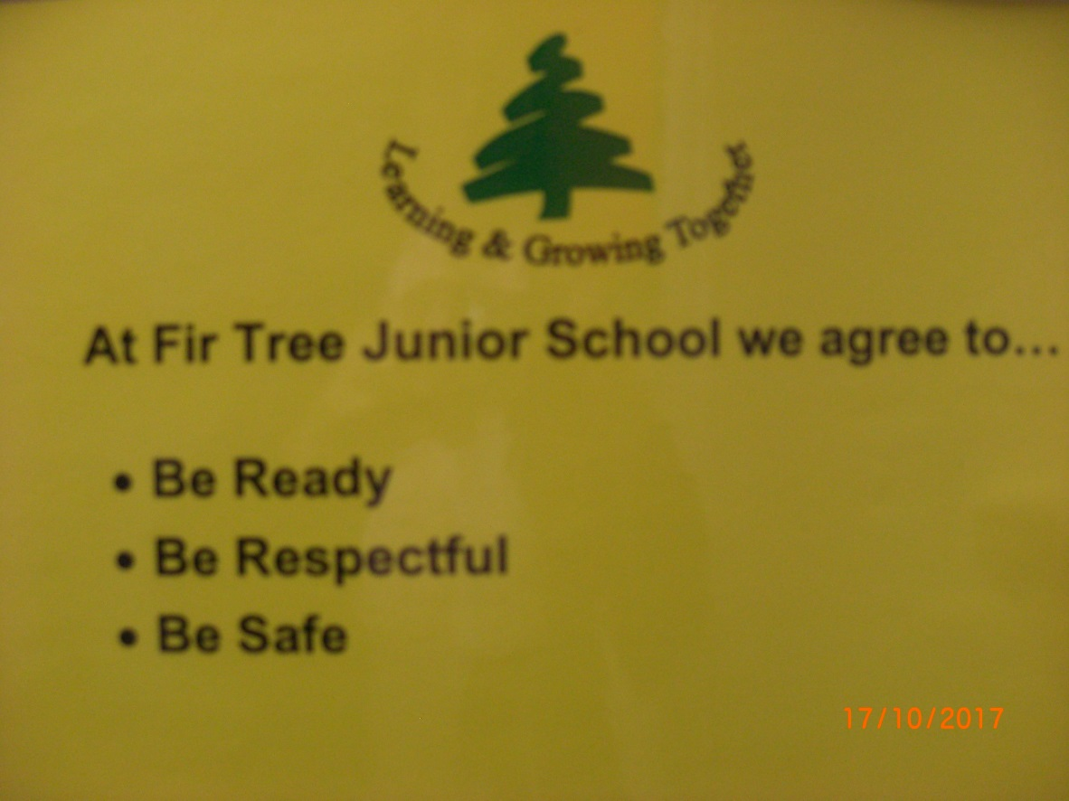
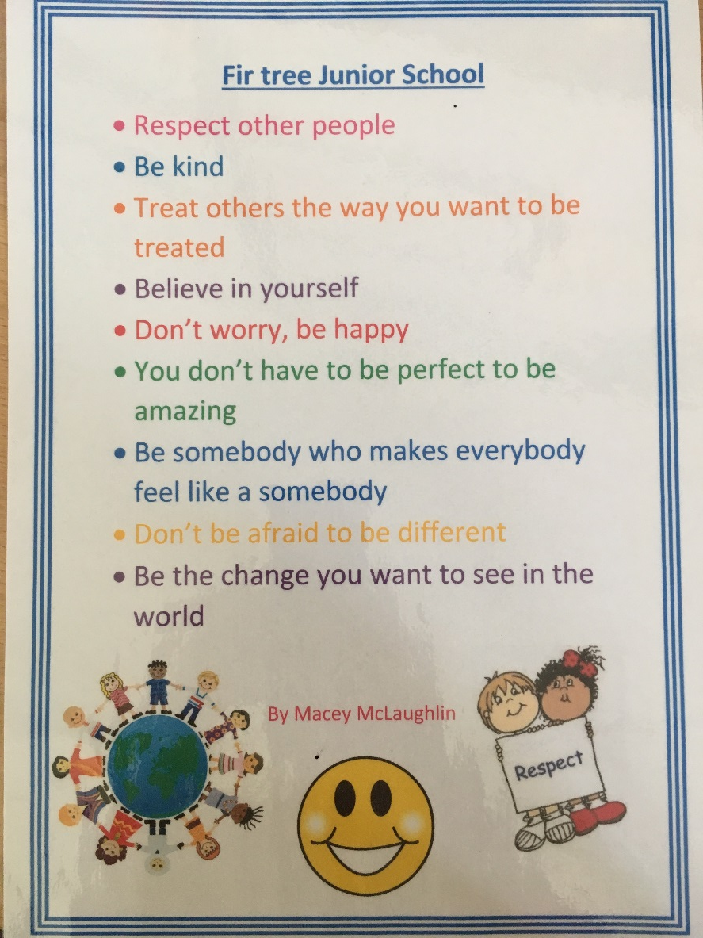
Our school agreement
What is your school agreement?

Slide 7
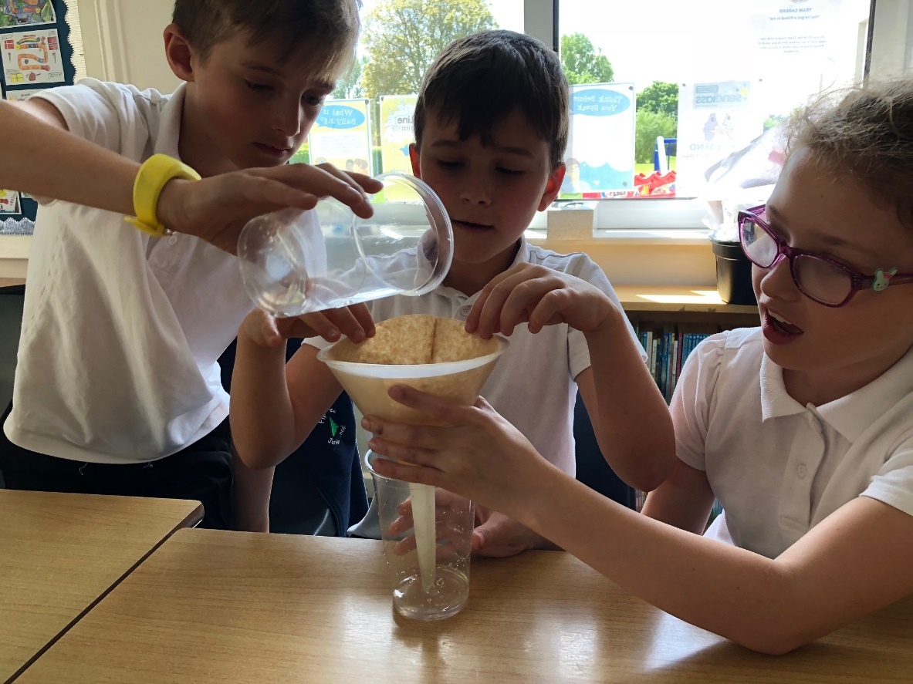
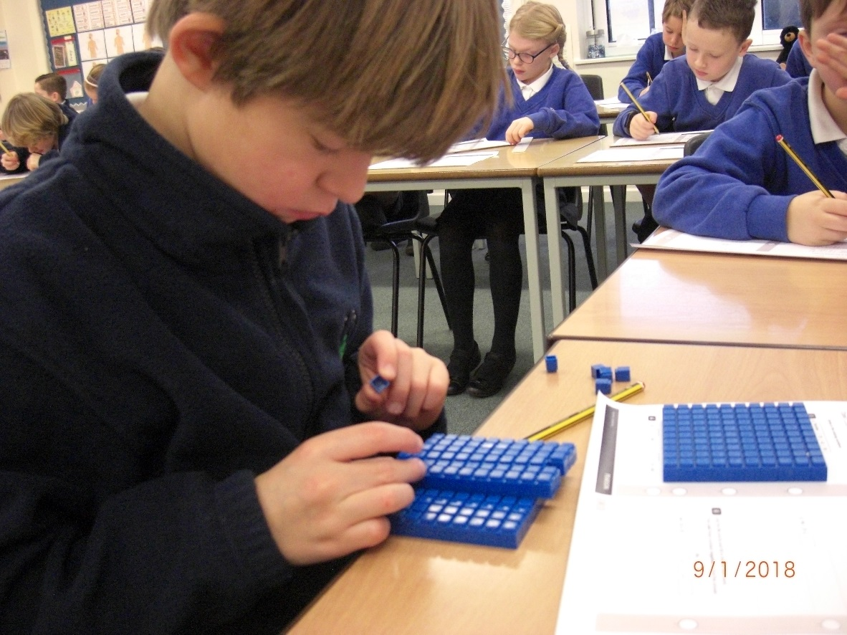
Our Learning
Science experiments
Using resources to help our maths

Slide 8
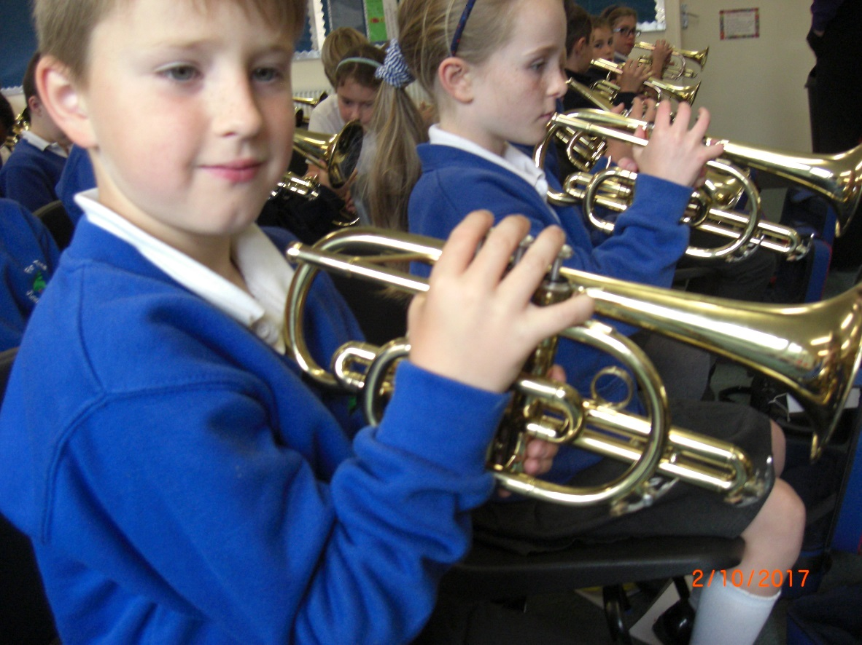
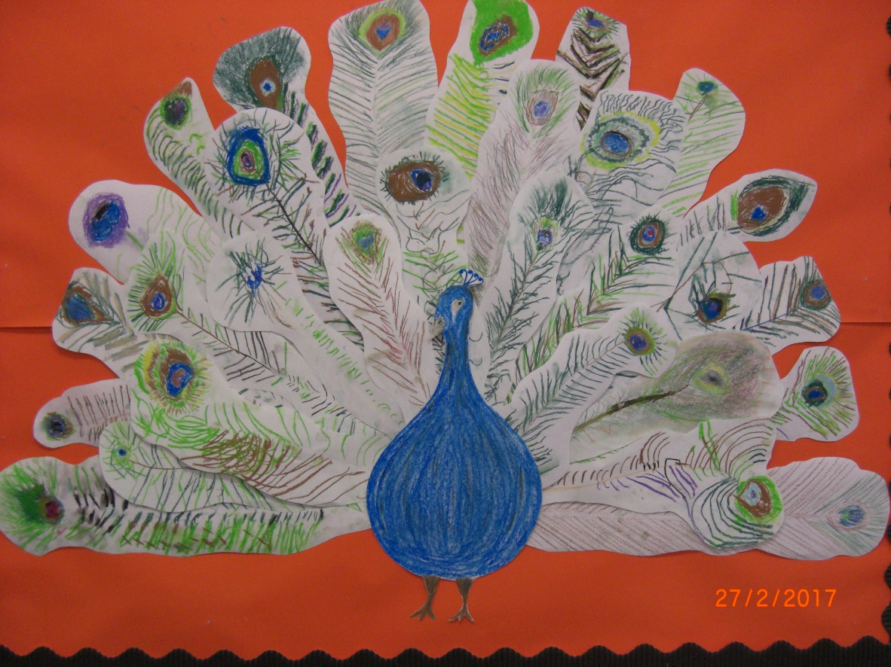
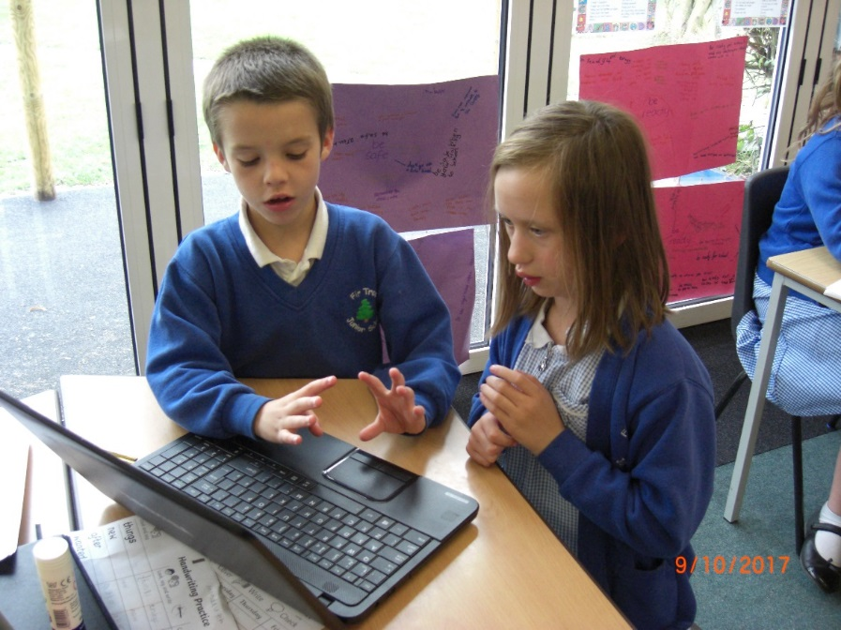
We learn how to play the cornet
Class artwork – everyone drew a feather to make this beautiful peacock
The bird of India
Working on our computer

Slide 9
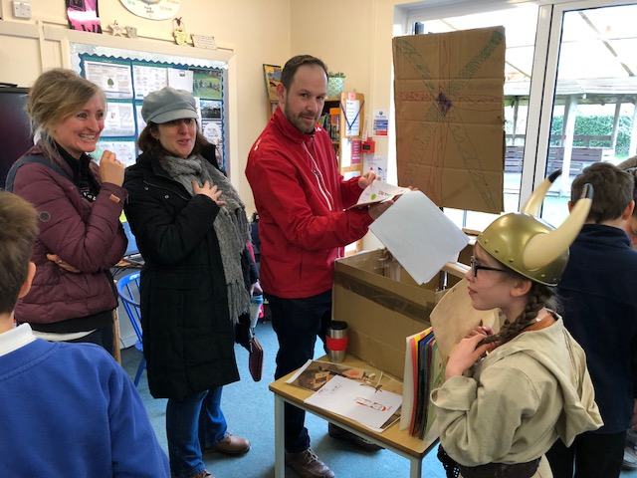
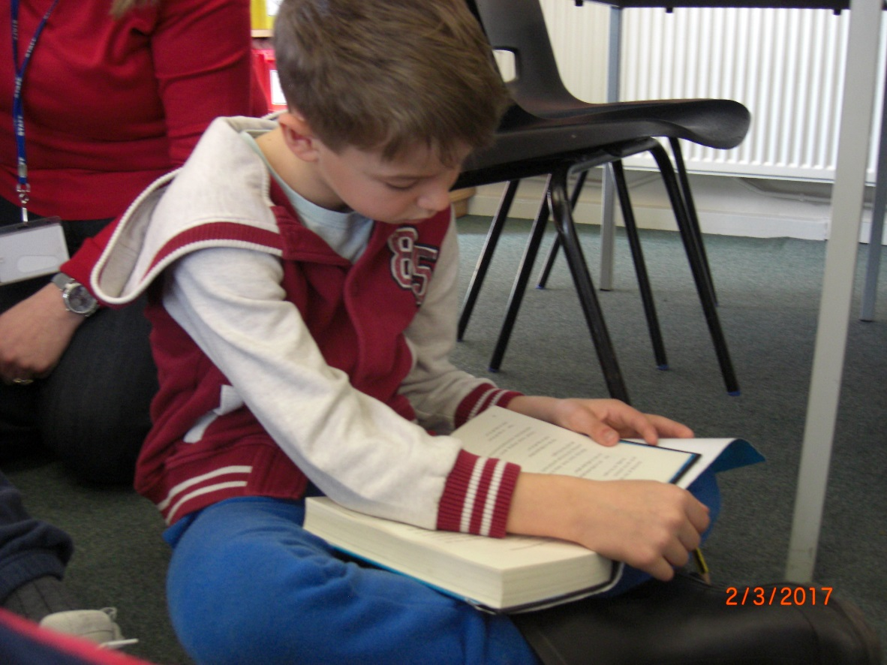
Open morning when all the parents see what we are learning about
World Book Day – we came to school dressed as our favourite book character

Slide 10
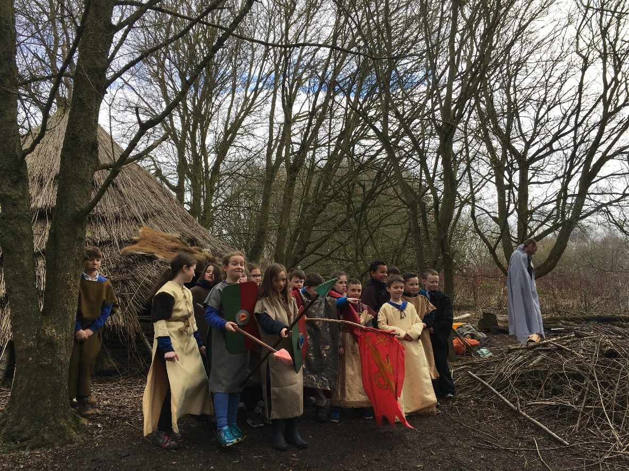
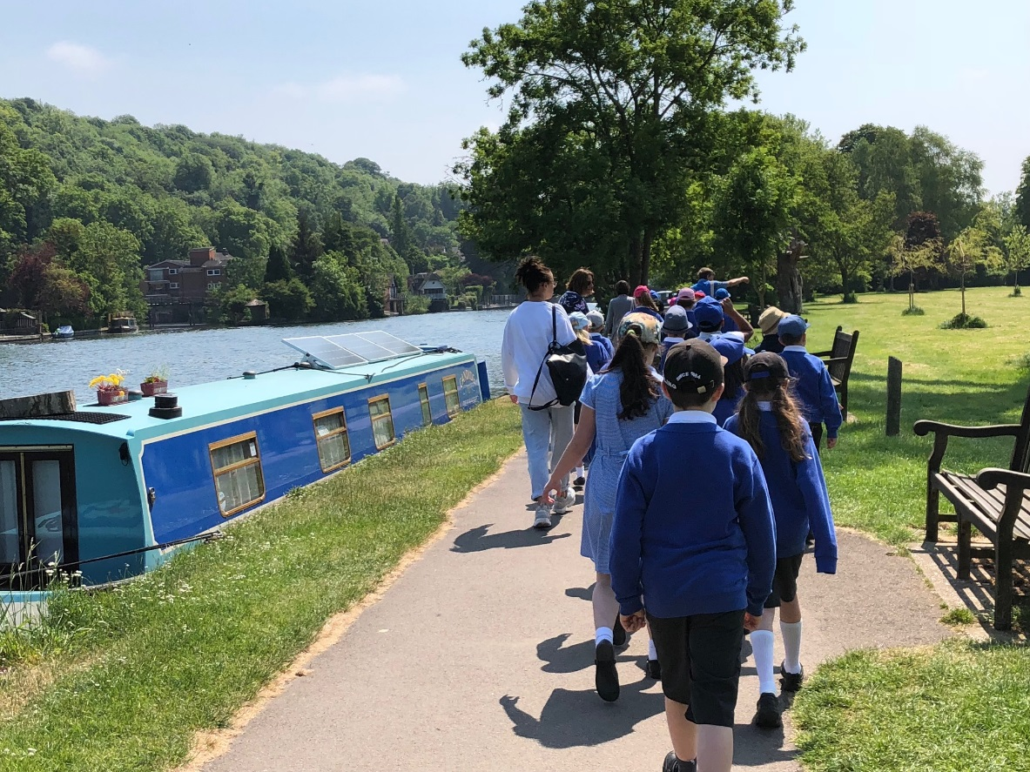
We went to a place called Hill End to learn all about being Anglo Saxons and Vikings (History). They were the first settlers in England
We went to the river to learn about rivers and we visited a museum
We go on visits to different places. Do you visit other places around your school to
learn new things?

Slide 11
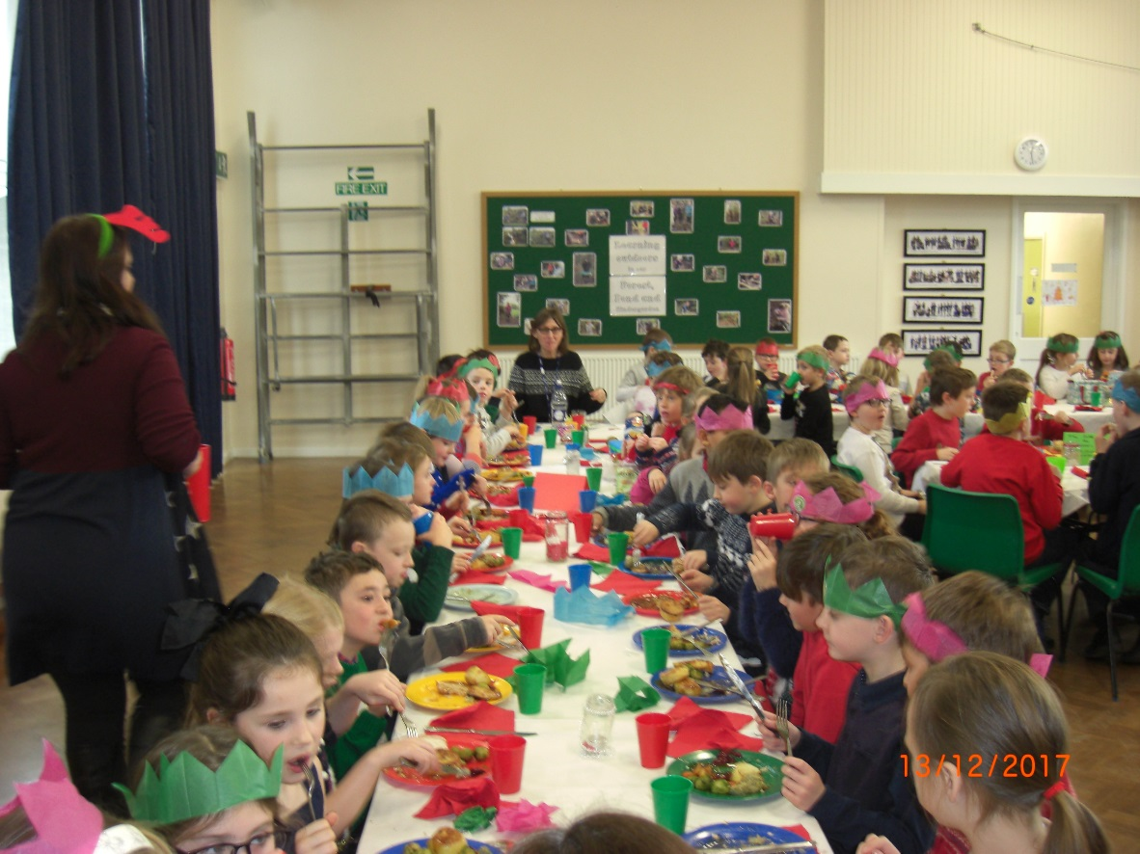
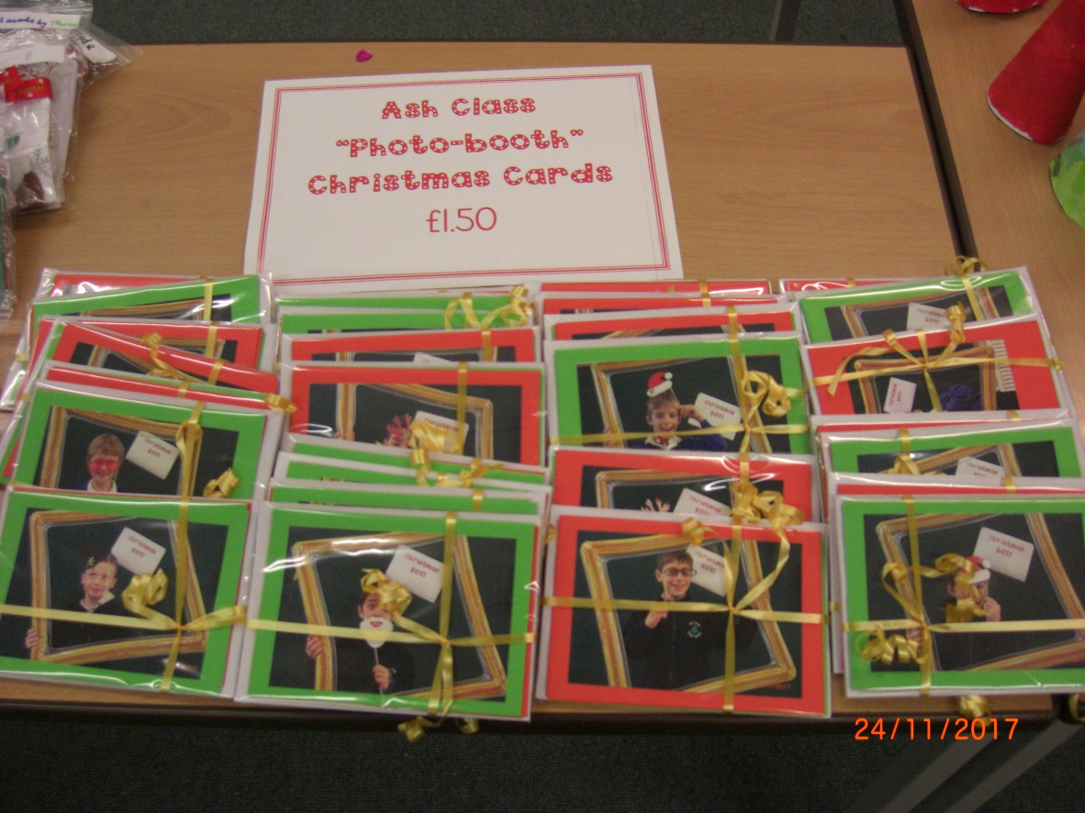
Wearing our Christmas hats and eating our Christmas dinner
In art we made cards to sell at our Christmas Craft Fayre
What did you do for Diwali?

Slide 12
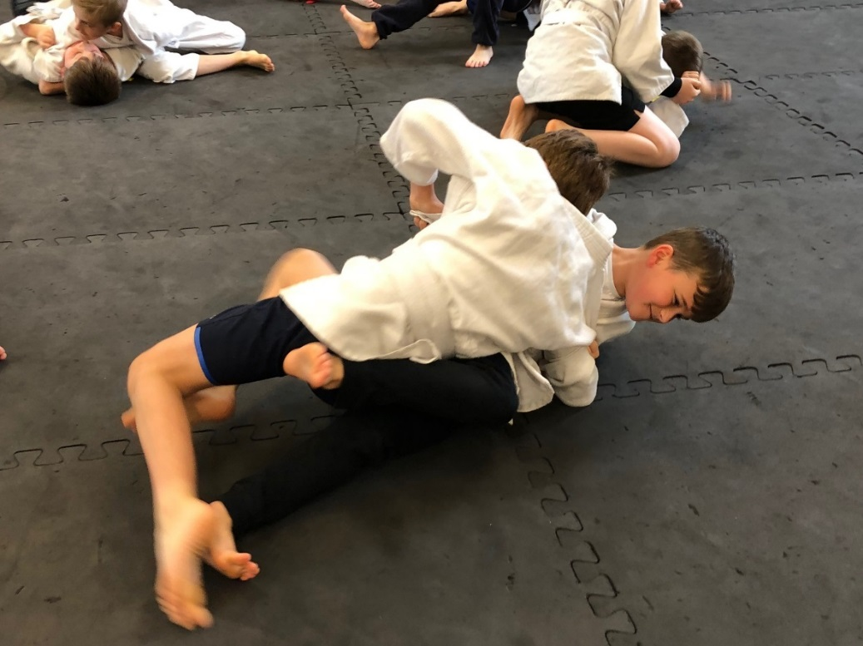
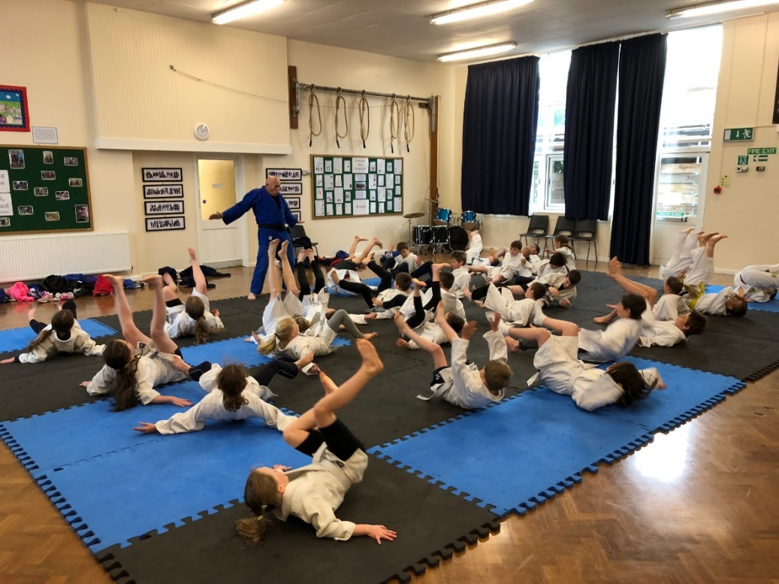
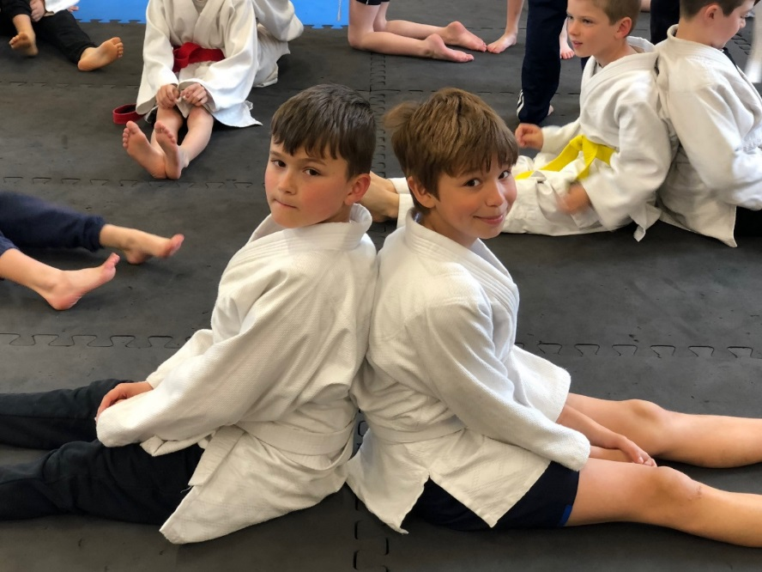
Judo classes
Everyone takes part in learning Judo
Hold down
Warm up exercise
Randori

Slide 13
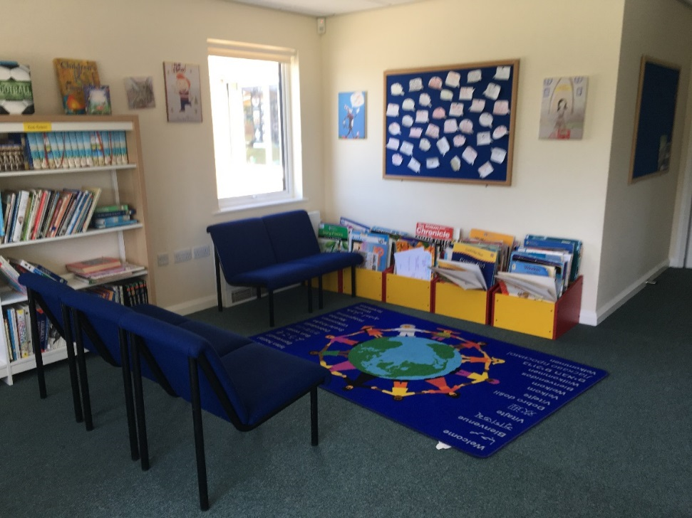
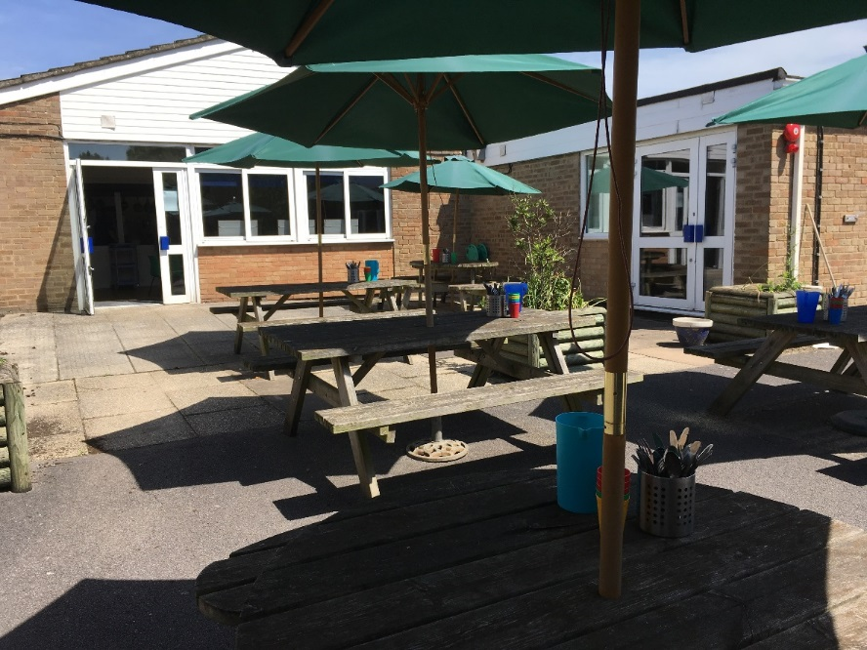
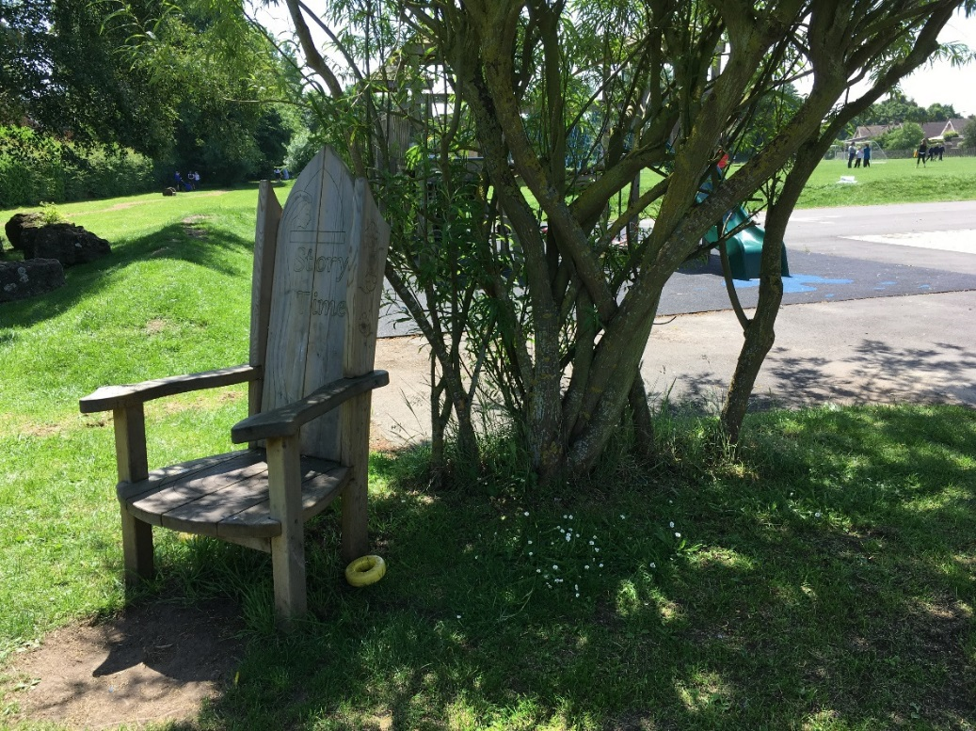
Around our school you will see….
Library
The Story Teller’s chair
Where we eat lunch
Our library

Slide 14
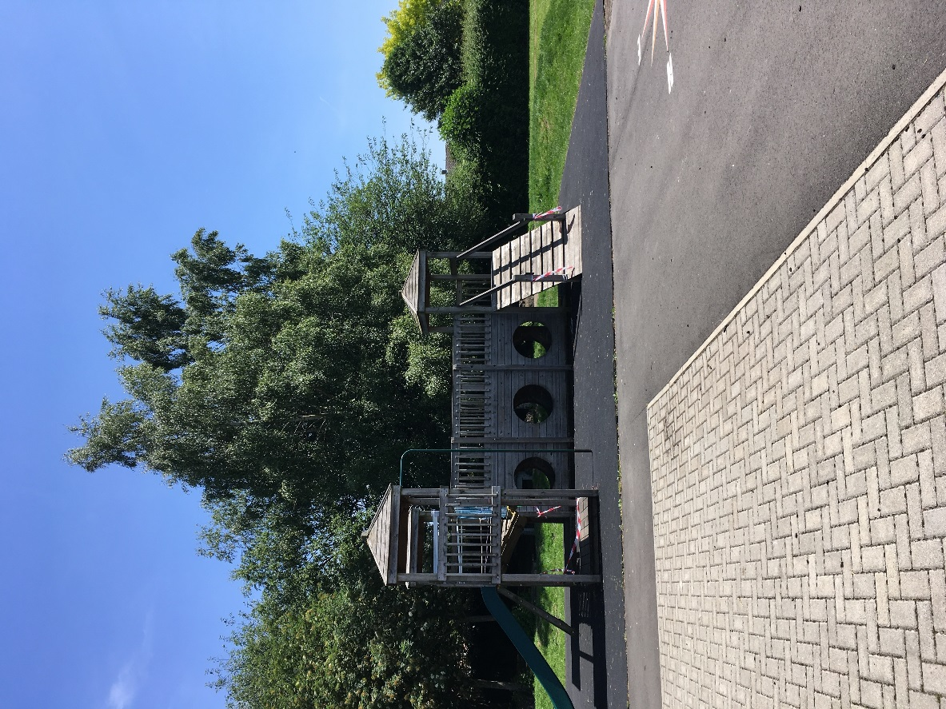
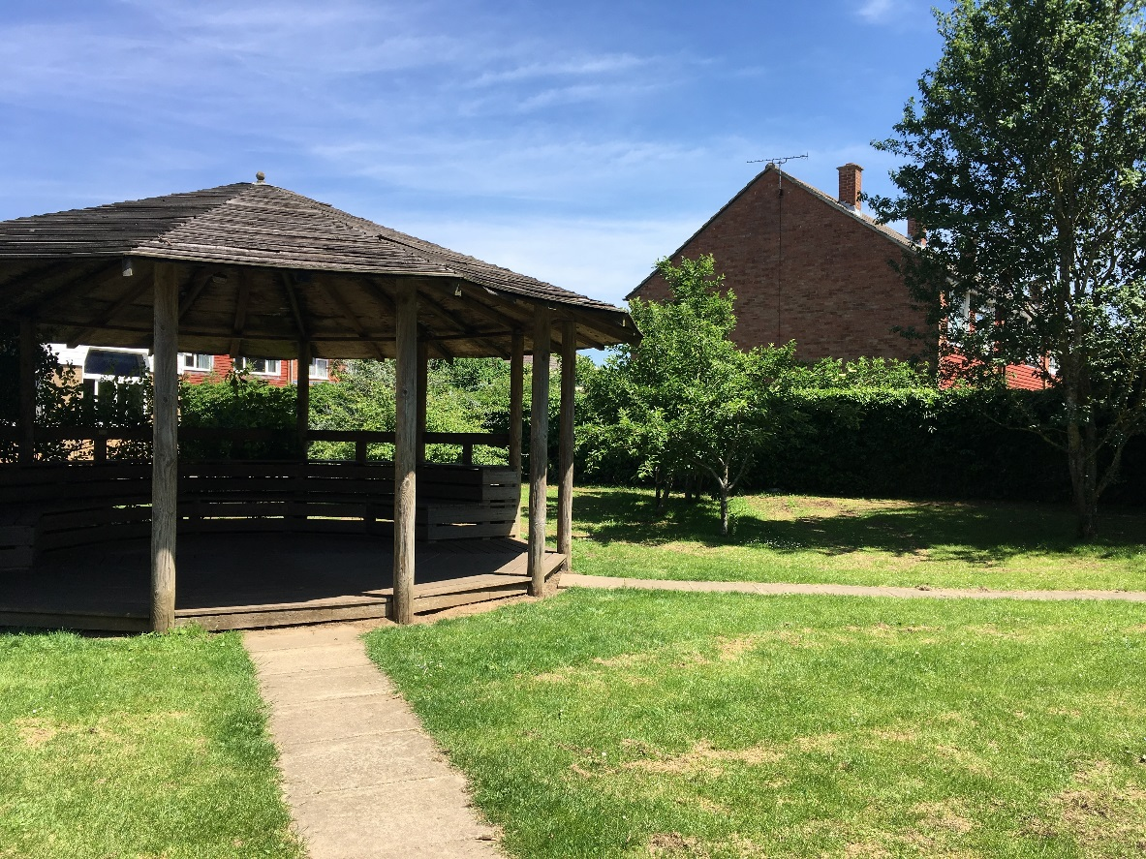
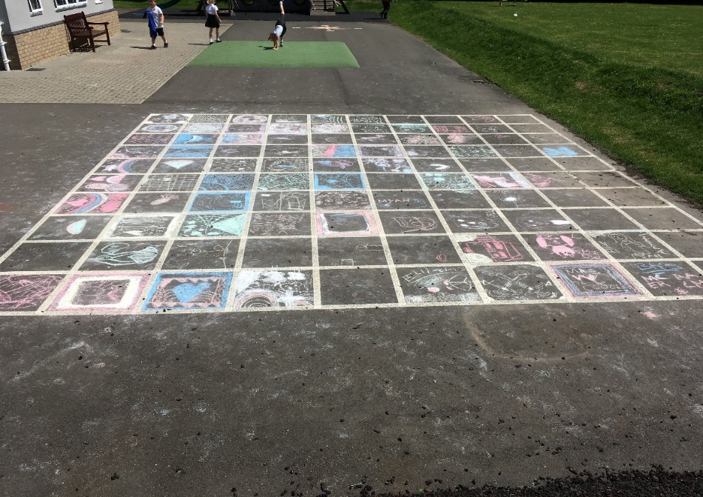
Climbing frame and
playground
The Castle

Slide 15
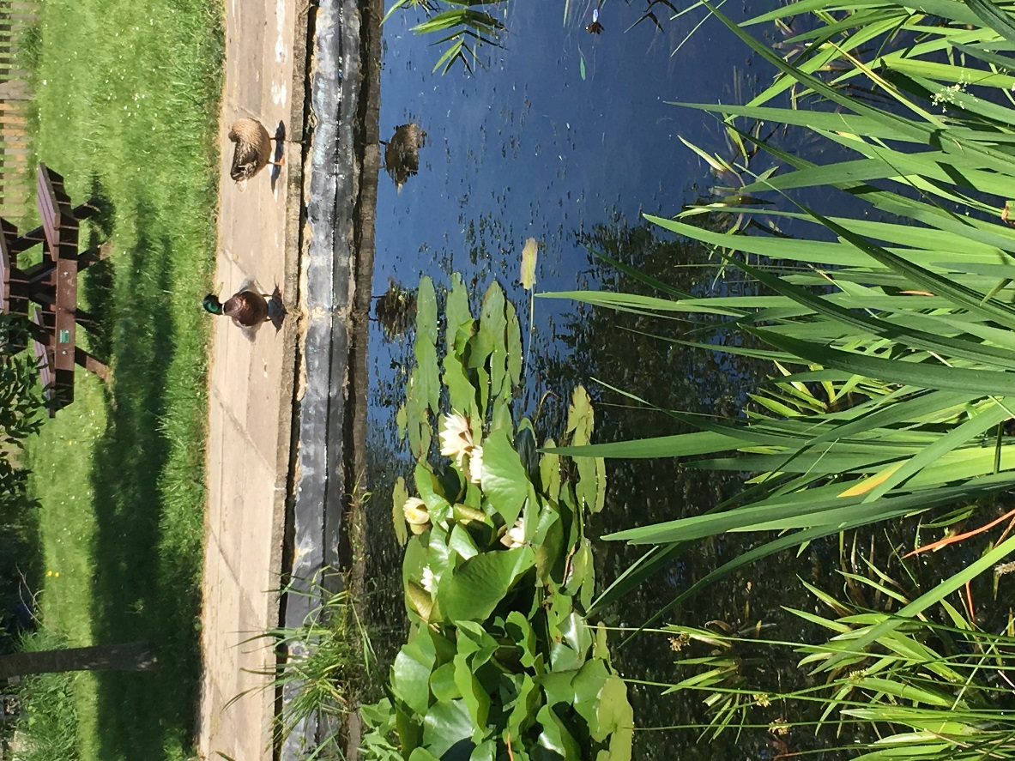
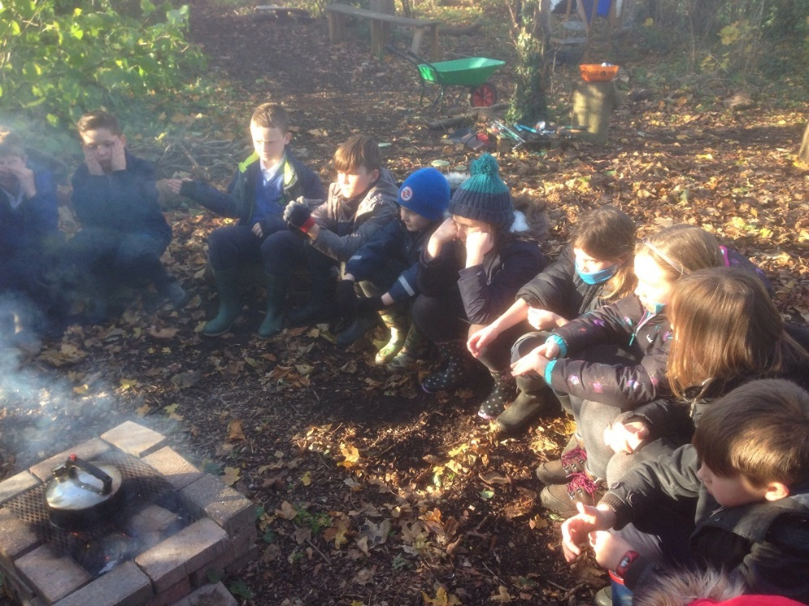
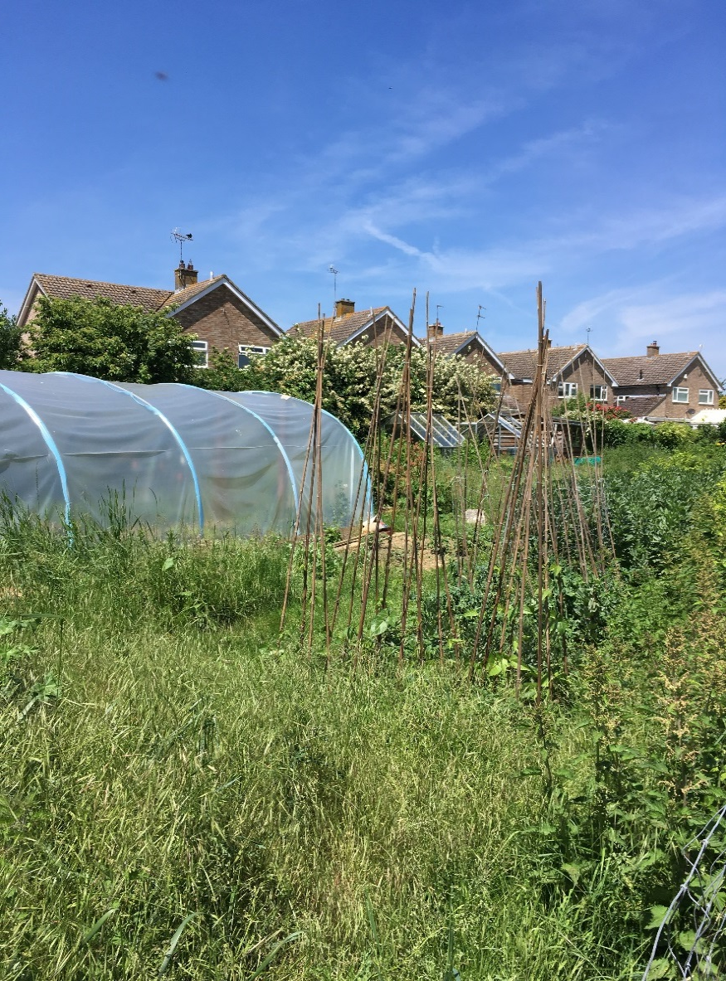
We cook in our own forest
Our pond where we learn about plants and insects. The ducks came too!
We grow vegetables in our garden

Slide 16
Class jobs
Each class has a job to do this helps us to run our school and keep it tidy
litter picking
finding lost property
choosing assembly music
delivering letters
sorting out the outdoor games
this helps us to run our school and keep it tidy
What jobs do you do around your school?

Slide 17
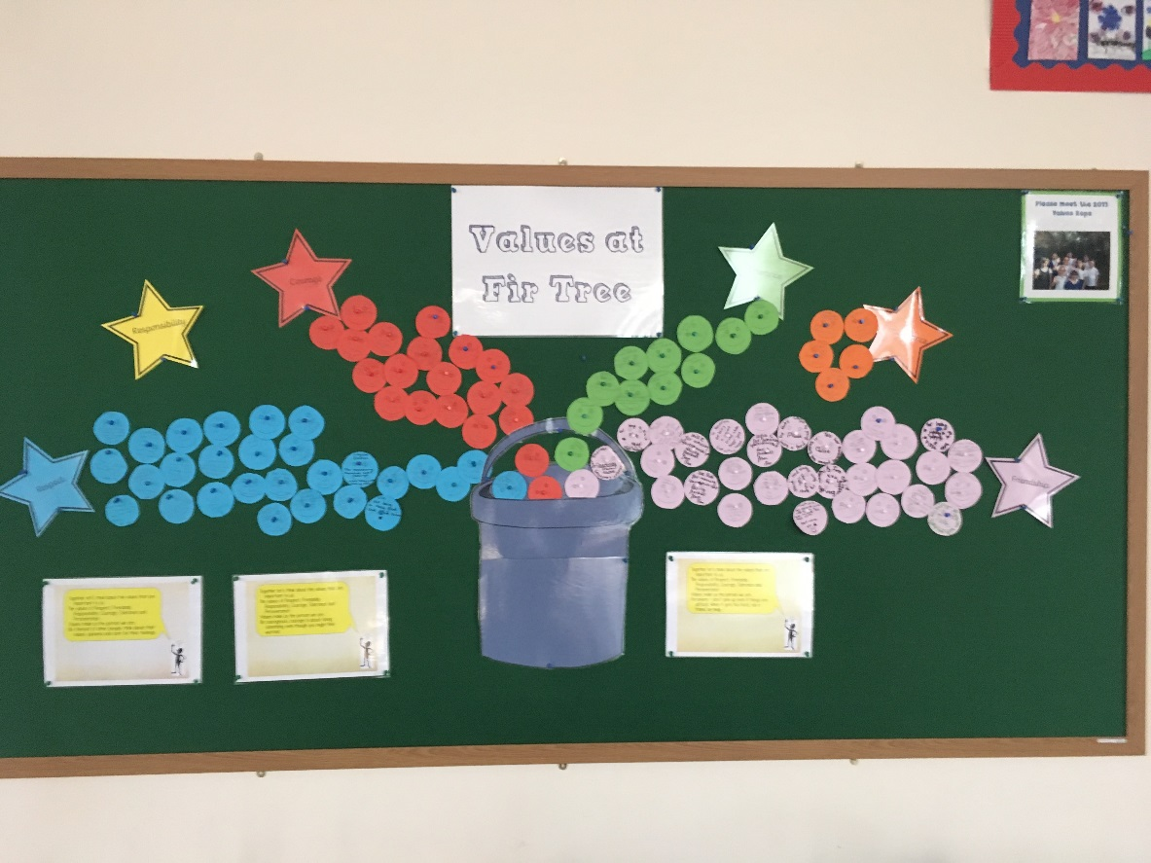
Our values
We have 6 values, they are:
Tolerance
Perseverance
Courage
Responsibility
Respect
Friendship
Our Values display board
What values do you learn about?

Slide 18
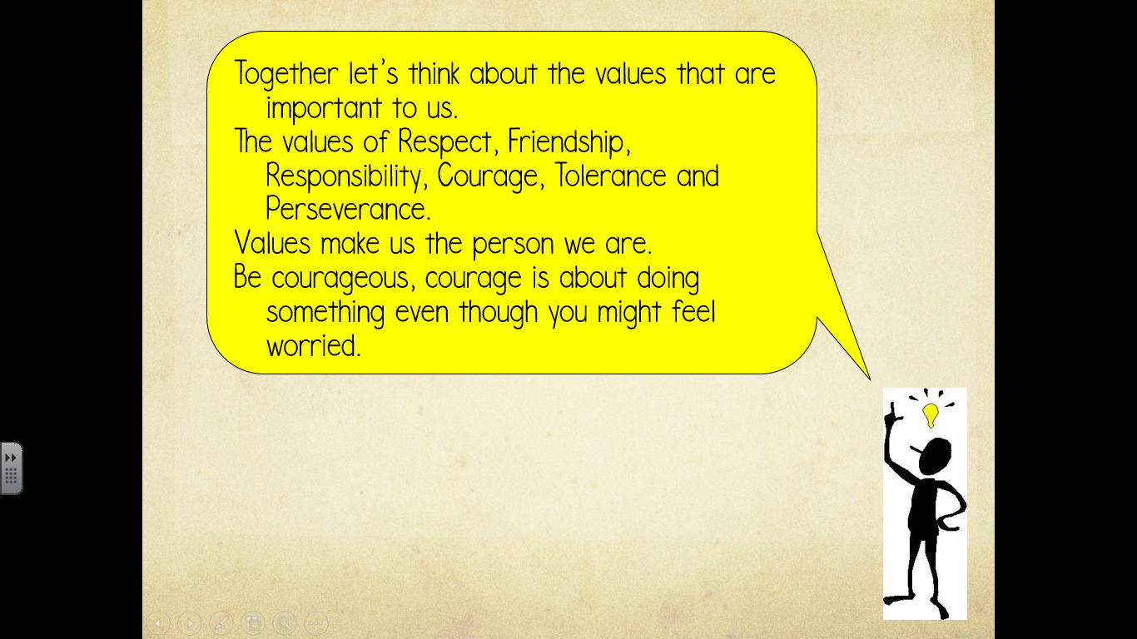
Our values reflection
We say this after our assemblies

Slide 19
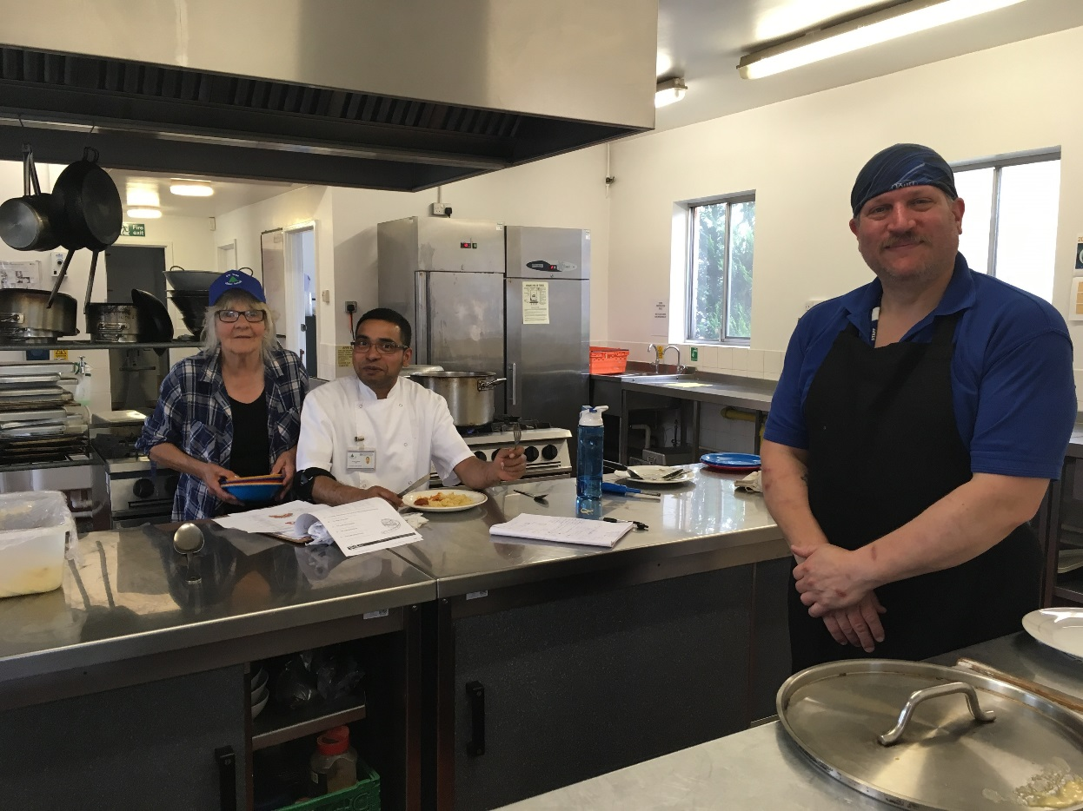
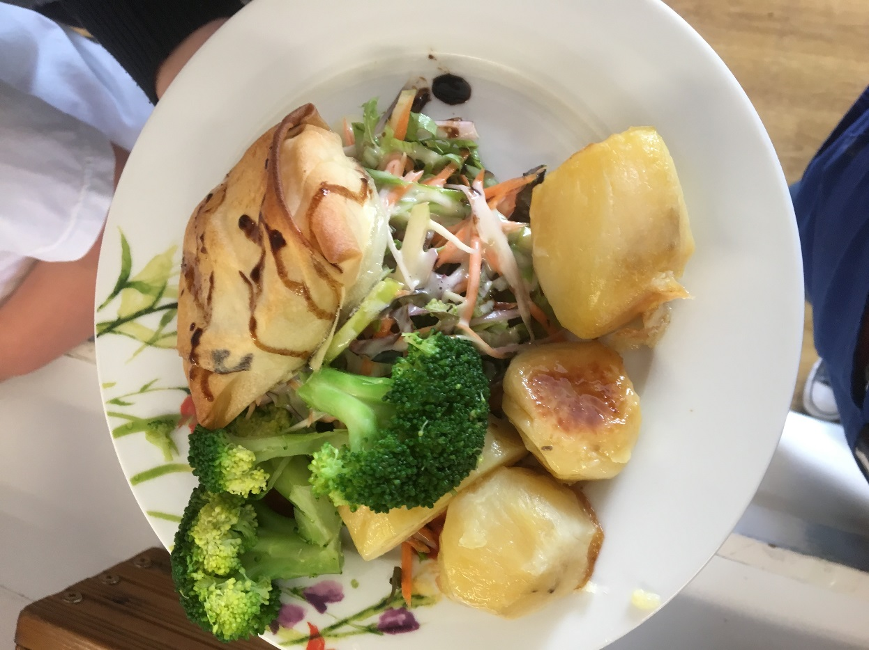
Siva and Felipe cook and serve our lunches
What are your favourite foods?

Slide 20
Our school lunches
Some of the children’s comments about school lunches are
Awesome
Lovely
Nice
Delicious
Tasty
Amazing
Fab
Yummy!

Slide 21
We hope you enjoyed looking at all the things that we do at our school. We feel safe in school, the learning is really good, we have brilliant teachers, we have an amazing chef who cooks healthy food for us to eat, we have a gardener, who helps us grow the food we eat. Best of all we have a helpful Head teacher, Ms Khan.
We hope to hear all about your school and the different things you learn.

