Slide 1

Reduce, Reuse and Recycle
By Year 5

Slide 2
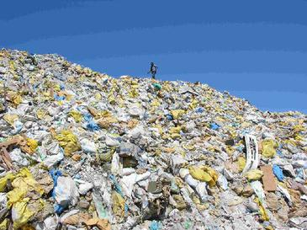
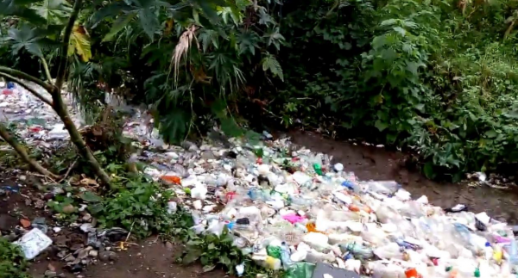

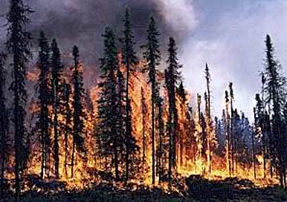
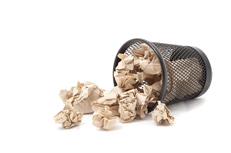
This is what our world would be like if we didn’t do the 3 R’s…..

Slide 3
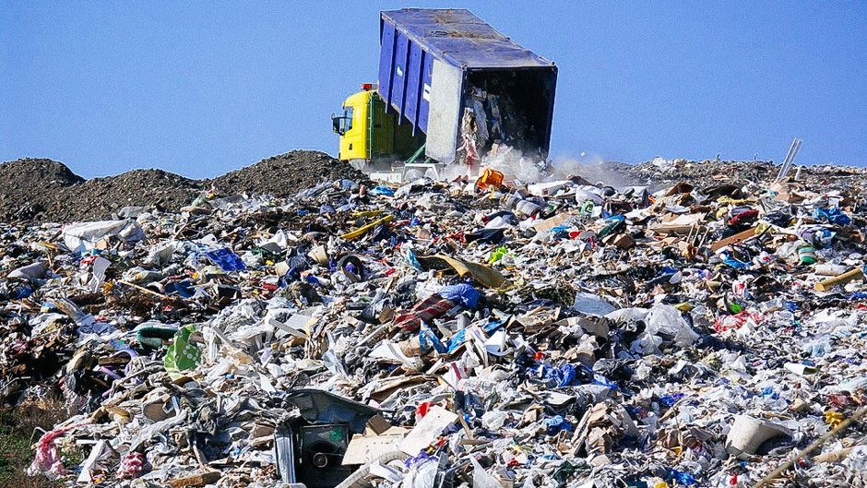
Waste
Waste is anything you throw away.
Did you know that 7 million tonnes of food waste is thrown away every year in the UK.
TRY NOT TO WASTE THINGS!!!!!

Slide 4

But at Fir tree we try to stop this happening!

Slide 5
Reduce
We reduce food waste by trying to eat all our meals or snacks.
Also we have bins all around Oxfordshire to reduce littering and to keep us safe!
We reduce clothes or other belongings by giving them into a charity shop*.
*A charity shop is a shop which sells your things to other people for them to enjoy.

Slide 6

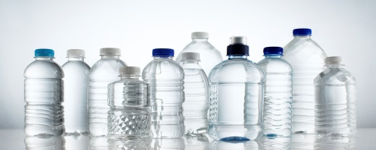
Reuse
We reused plastic bottles by turning them into pieces of art work.
You can reuse a jar and turn it in to a glitter holder!!!
Instead of throwing things away you can reuse them!!!
99% of rubbish you use is used wisely!

Slide 7
Recycle
You can recycle materials like aluminum, cardboard, electric, glass and metal.
1 recycled tin can would save enough energy to power a tv!
99% of rubbish was recycled and 1% was turned into landfill by Sweden.
Materials with greases in cannot be recycled.

Slide 8
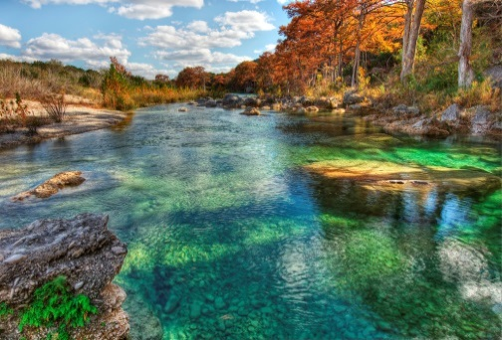

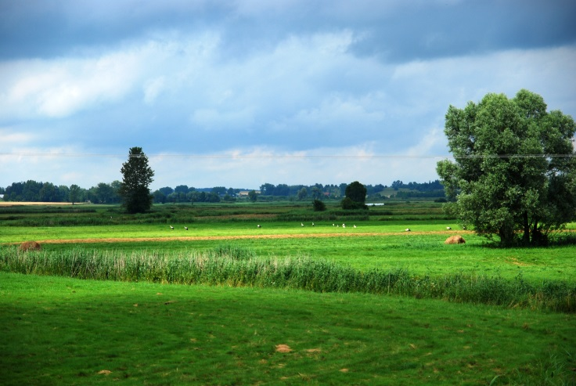


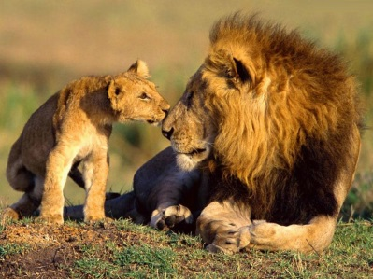


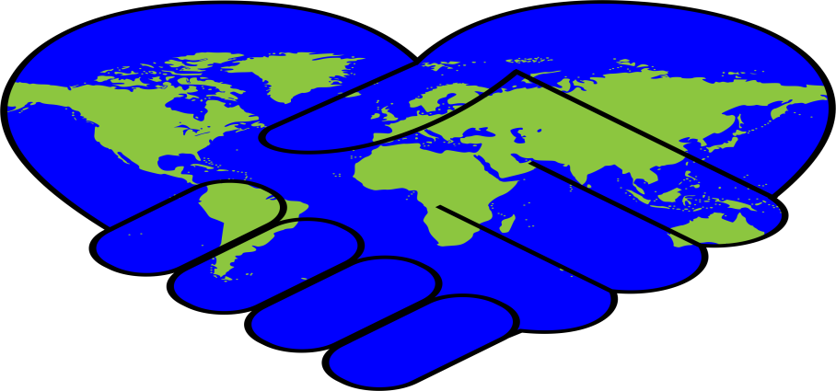
If we did all of these things are world would be like this…

Slide 9
We found out that….
Sweden is so good at recycling that it is now importing rubbish from other countries. They are making reusable energy with rubbish
Only 1 per cent of Swedish household waste is sent to landfill. Everything gets recycled
India is beginning to recycle plastics to make sure plastics don’t end up in landfills

Slide 10


Thank you for watching
What more can you do to reduce waste?

