Slide 1
Our School
Pupils of CE2 – CM1
Béziers - France

Slide 2
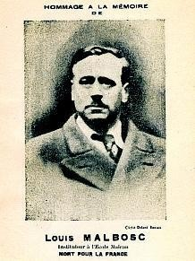
Our school is called Louis Malbosc. He is a famous person in France. He was a school teacher and was resistant during the Second World War.

Slide 3
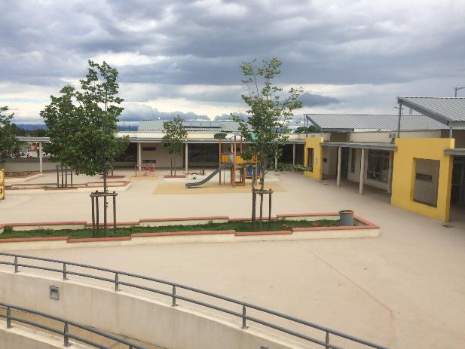
It’s a big school, There are 15 classes.
5 in nursery and 10 in primary.

Slide 4
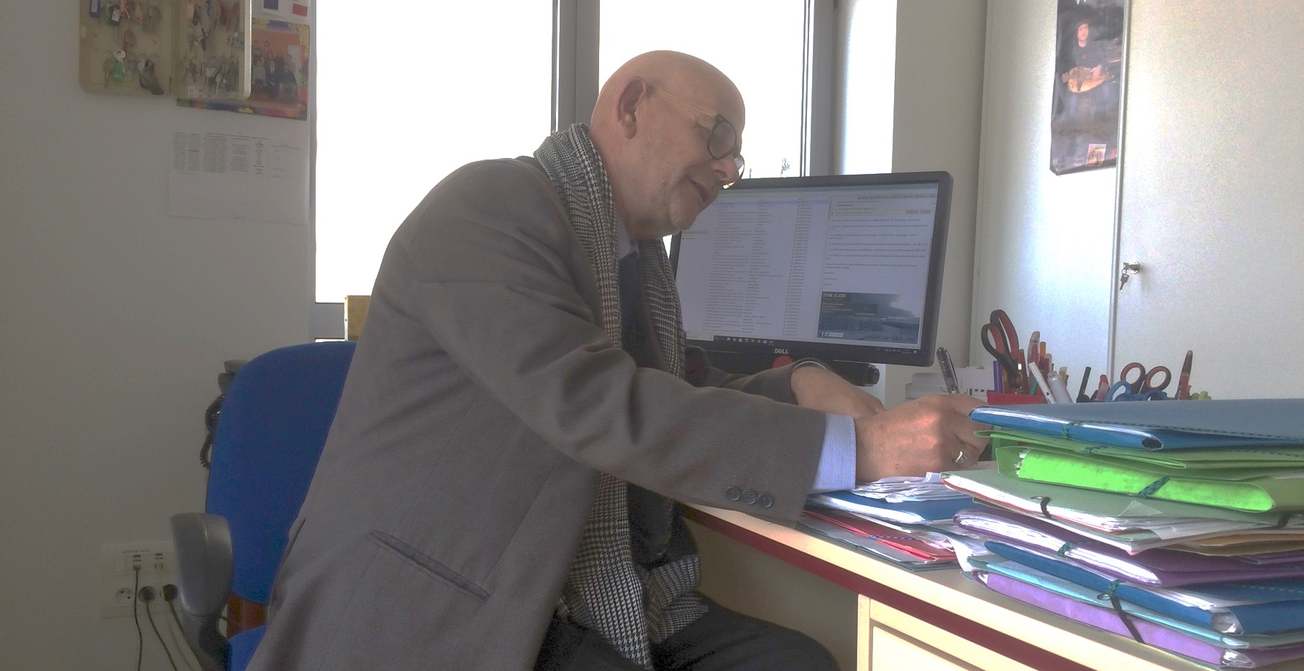
Our director at work.

Slide 5
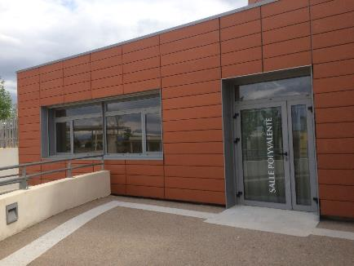
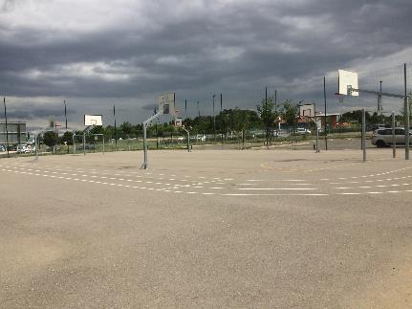
In our school we have a lot of places to learn.
an auditorium
A stadium

Slide 6
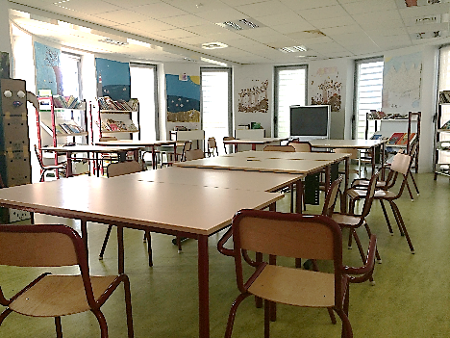
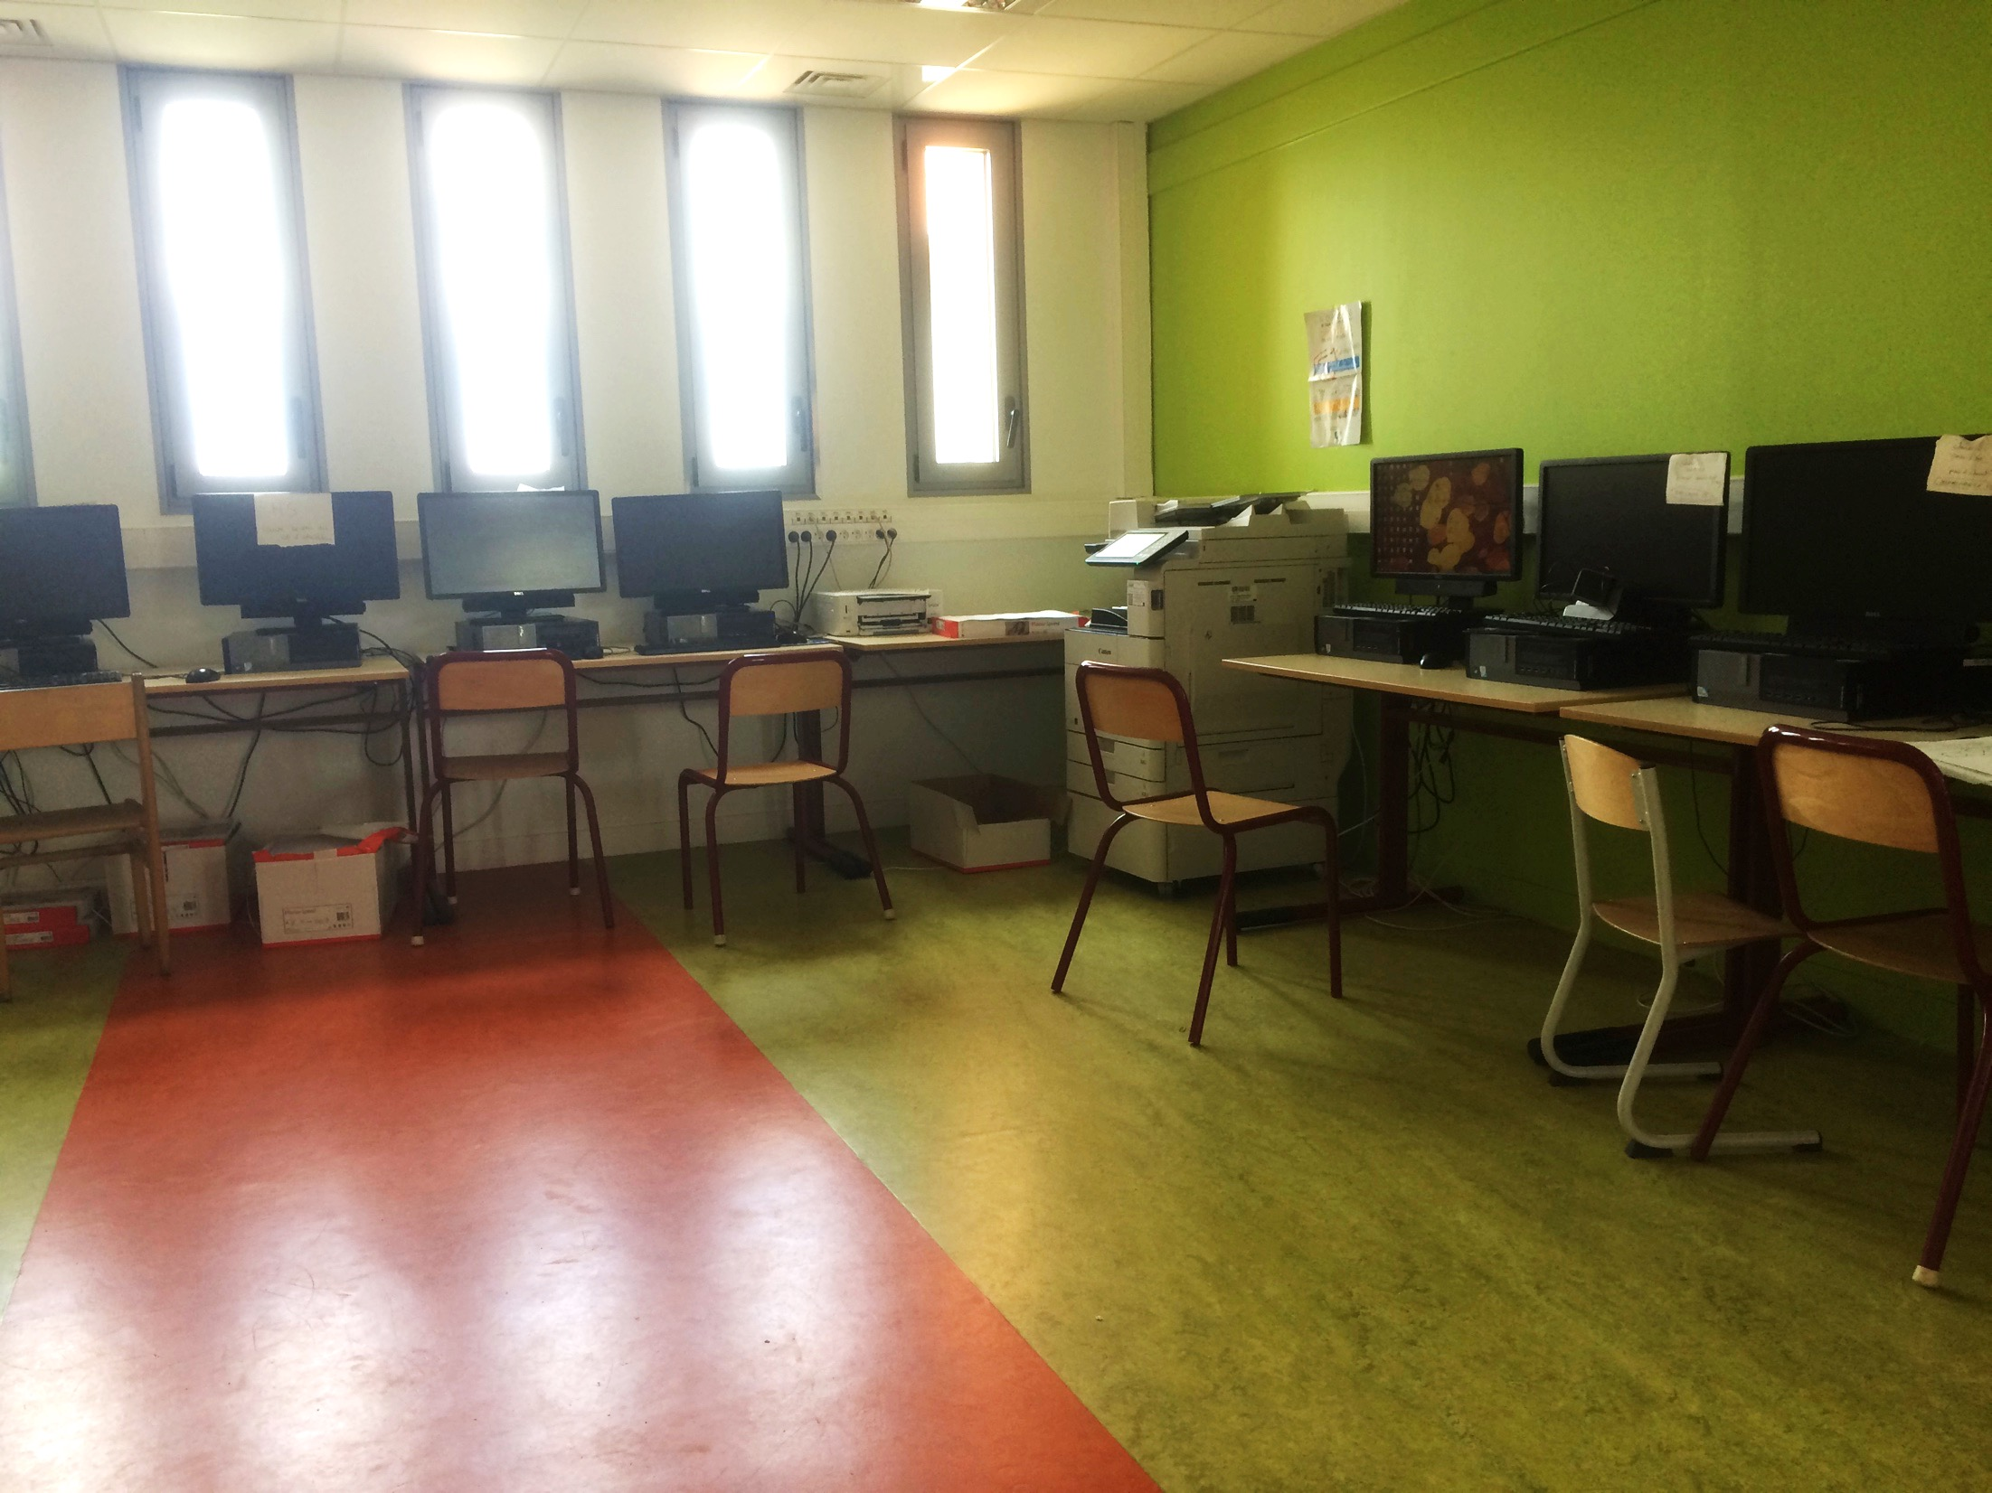
A library
A computer lab

Slide 7
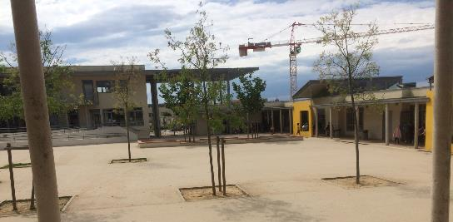
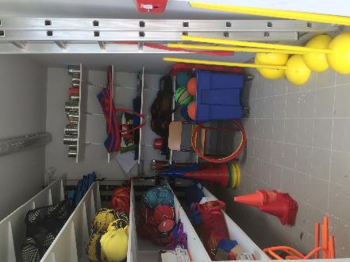
In the playground, we can play football, jump rope, tops, ball games.

Slide 8
Our class picture

Slide 9
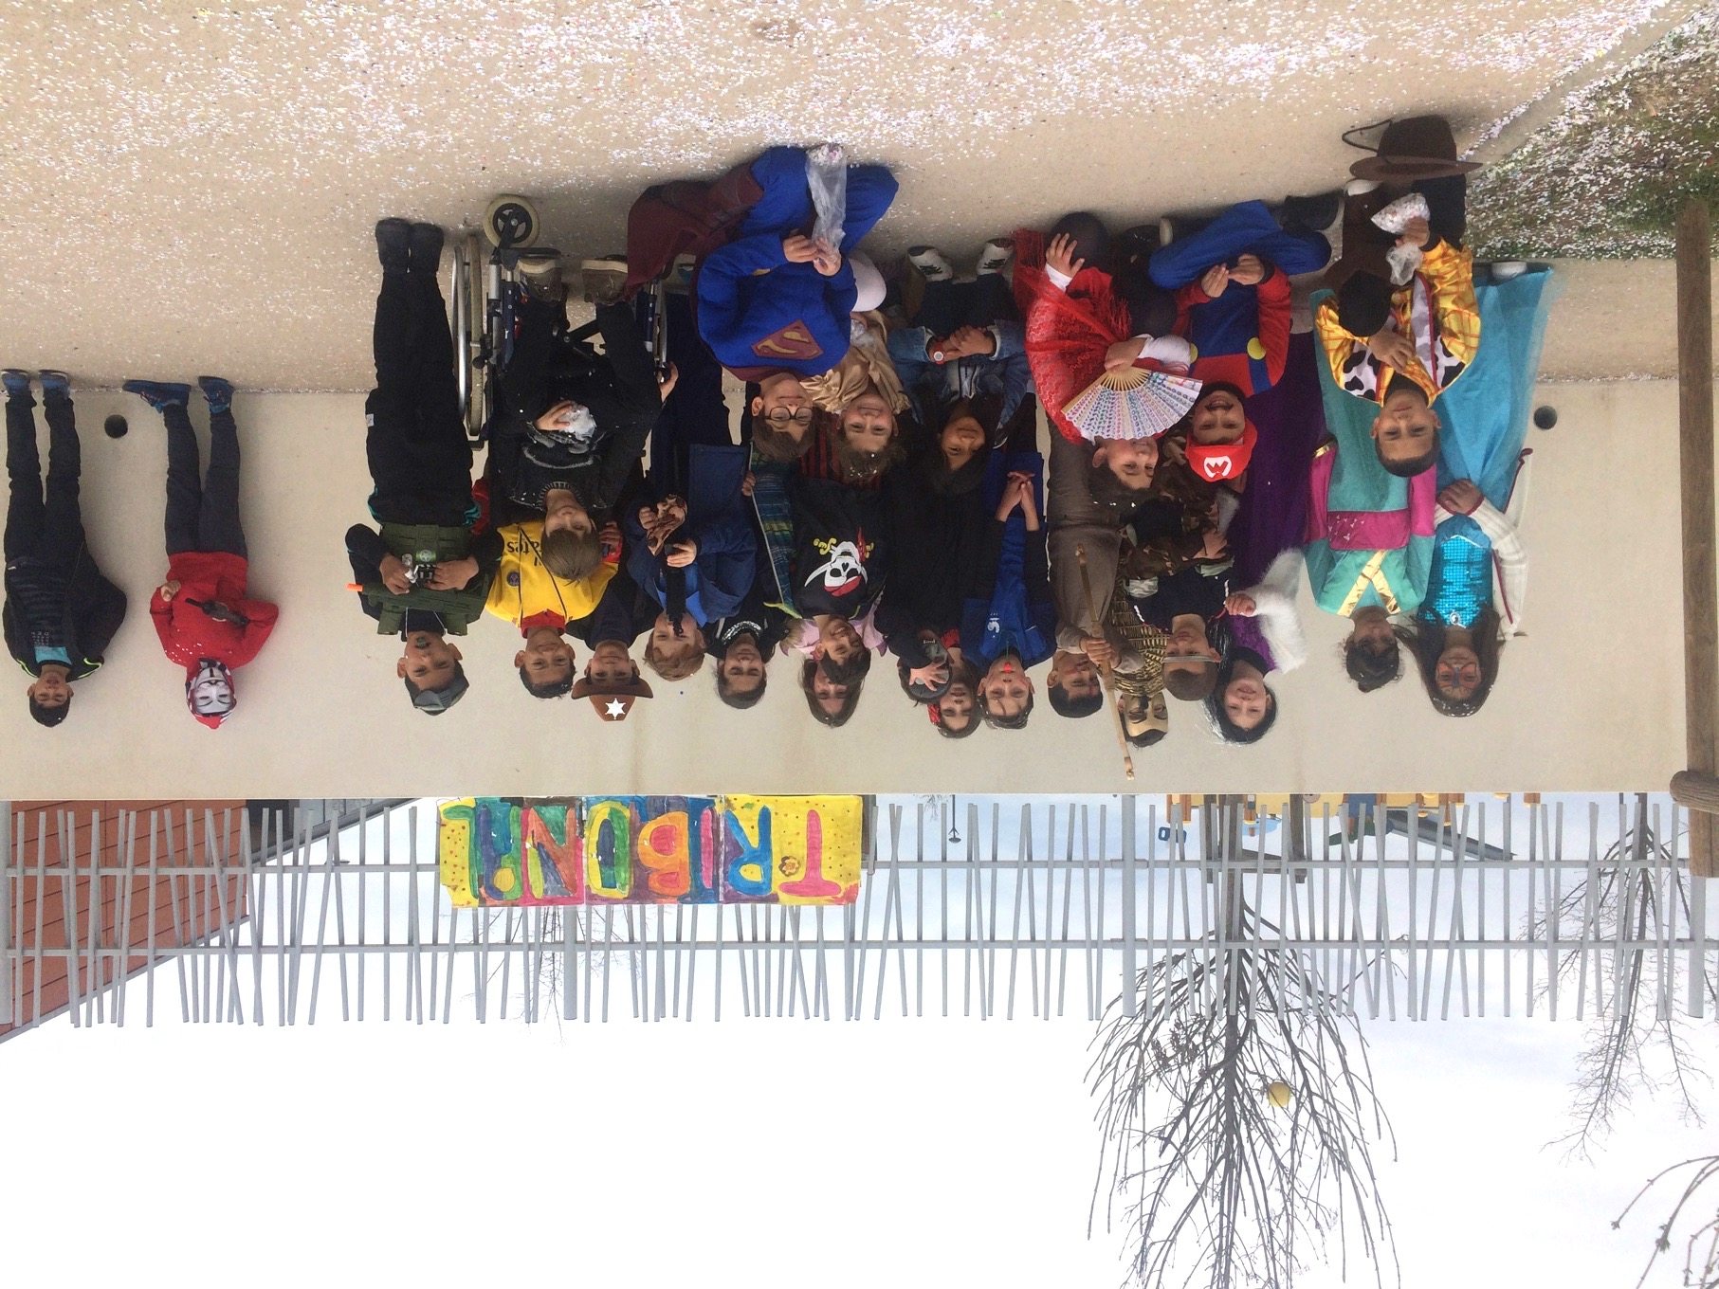
Picture of our class at the carnival. We had a very good day.

Slide 10
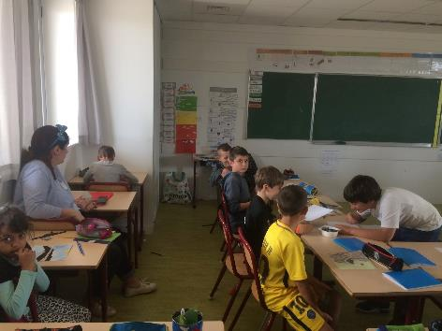
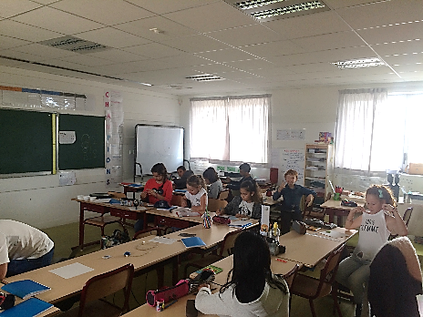
We love doing plastic art. At the moment, we are working on Vincent Van Gogh, a dutch painter.

Slide 11
And you, how is your school?
We can not wait to find out more.

