Slide 1
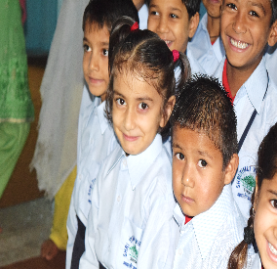
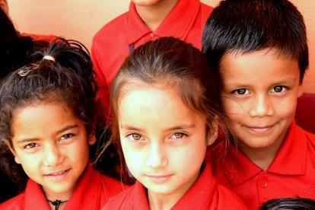
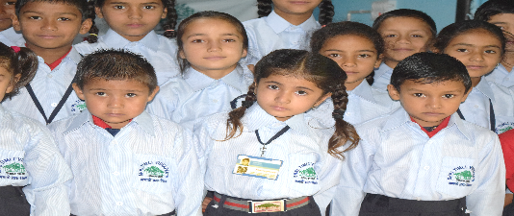
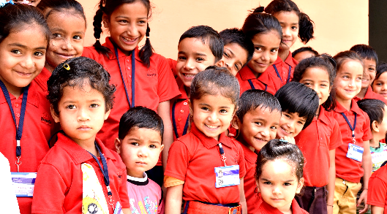
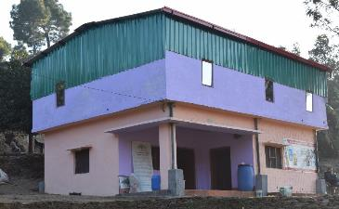
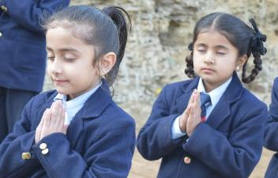
Visiting
Mainspring (Timli Vidyapeeth)
School in India
Notes:
Website for Mainspring Timli School is www.mainspring.in & www.universalgurukul.in. Facebook: www.facebook.com/theuniversalgurukul
This is the primary school programme within the broader Timli Vidyapeeth (the school in the village of Timli) which is a central part of the Universal Gurukul (training centre) programme.

Slide 2
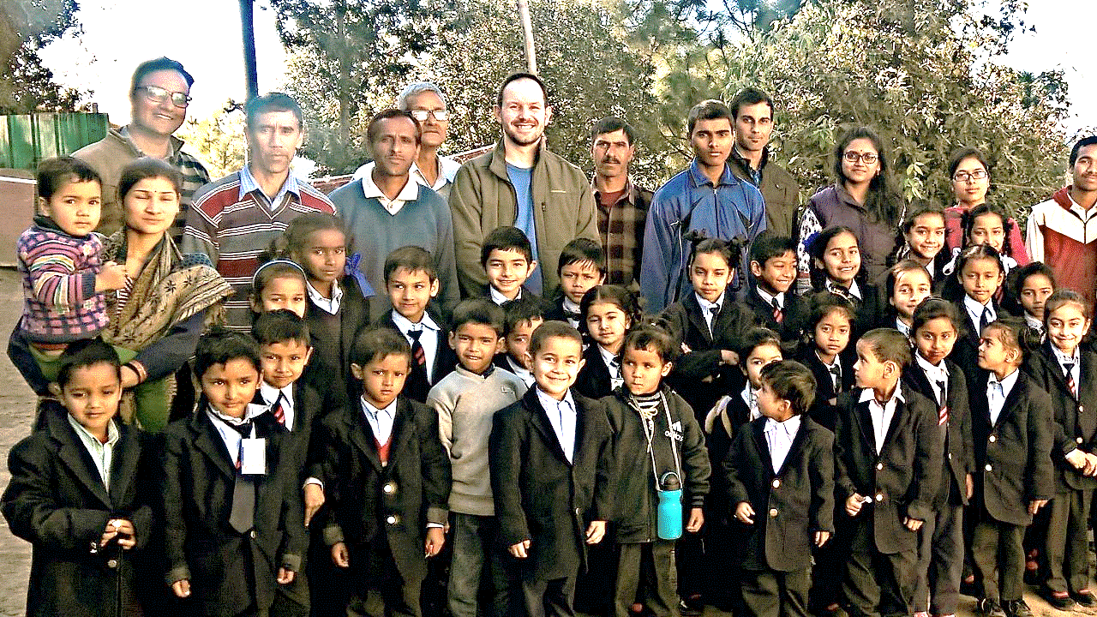
Notes:
Eric Anderson, meeting the children, parents and teachers. There are 33 children enrolled and 3 teachers (Meha, Suman & Hemraj).

Slide 3

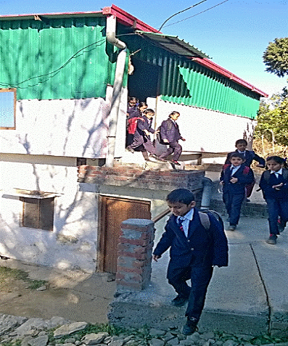
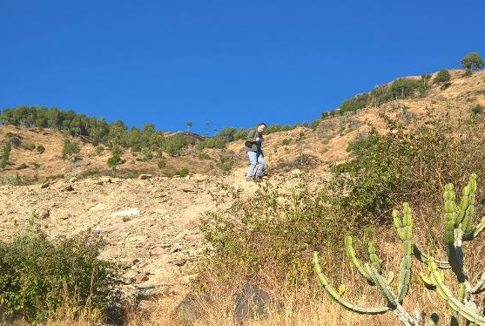
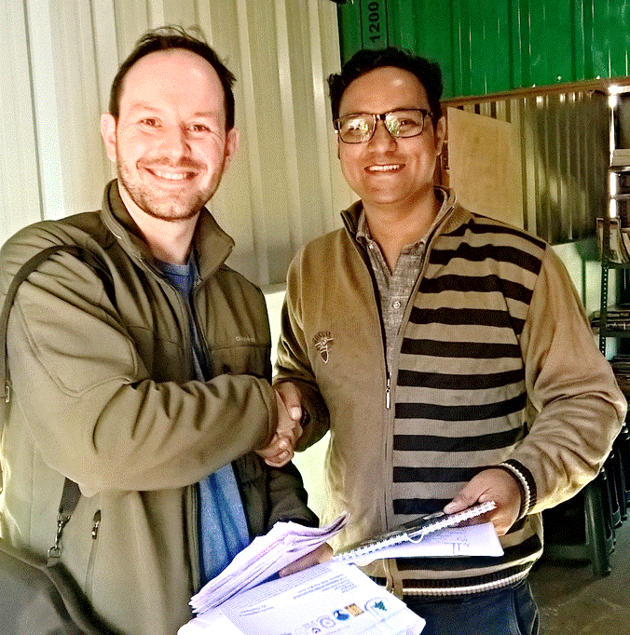
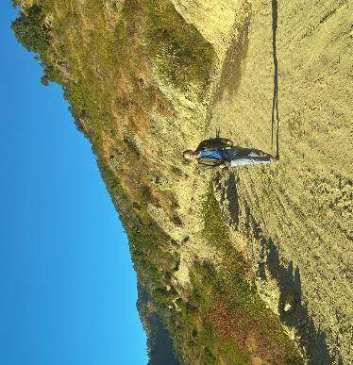
Notes:
Top Left: Eric Anderson at Timli Vidyapeeth – Mainspring – A view of Himalayas.
Top Right : Students coming out from their classrooms.
Bottom Left: Eric Anderson (parent of students at Fir Tree Junior School) and Ashish Dabral (Chairman at Mainspring Timli School) swapping the children’s letters.
Bottom Middle: Eric Anderson on the way to Timli Vidyapeeth.
Bottom Right: Eric Anderson on the way to Timli Vidyapeeth – Organic Farms.

Slide 4
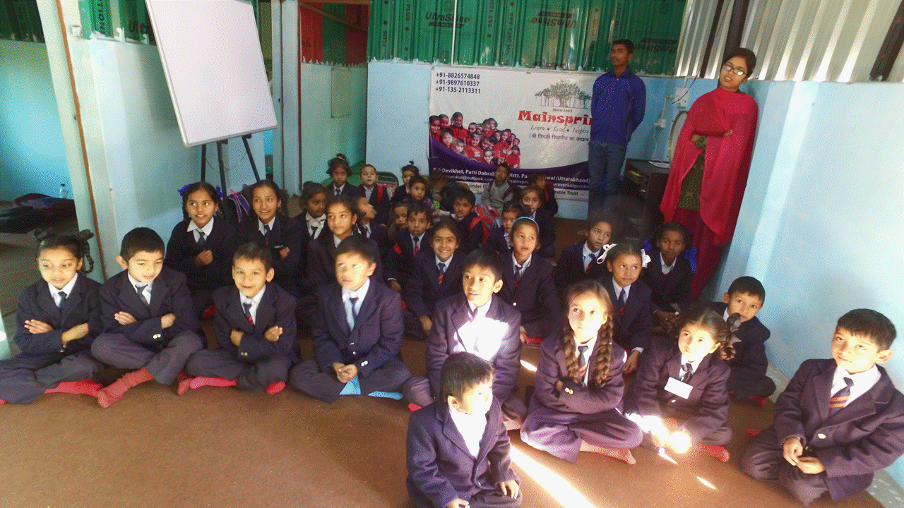
Notes:
The main classroom – the largest of four rooms.

Slide 5
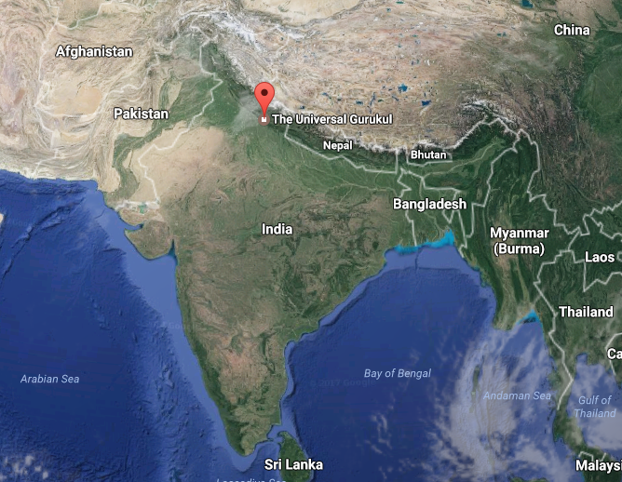
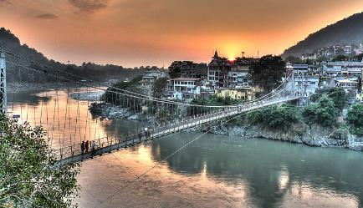

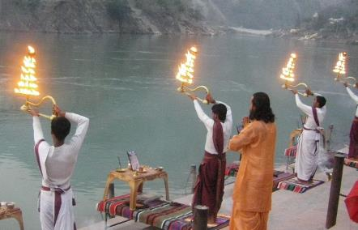
Notes:
Left: Red dot is the location of Mainspring (Timli Vidyapeeth) School.
Right Top : Rishikesh – The nearest town to Timli Vidyapeeth (70 Kilometers).
Right Middle : Prince Charles & Camilla at Rishikesh.
Right Bottom: Evening prayers at Ganges river bank.

Slide 6
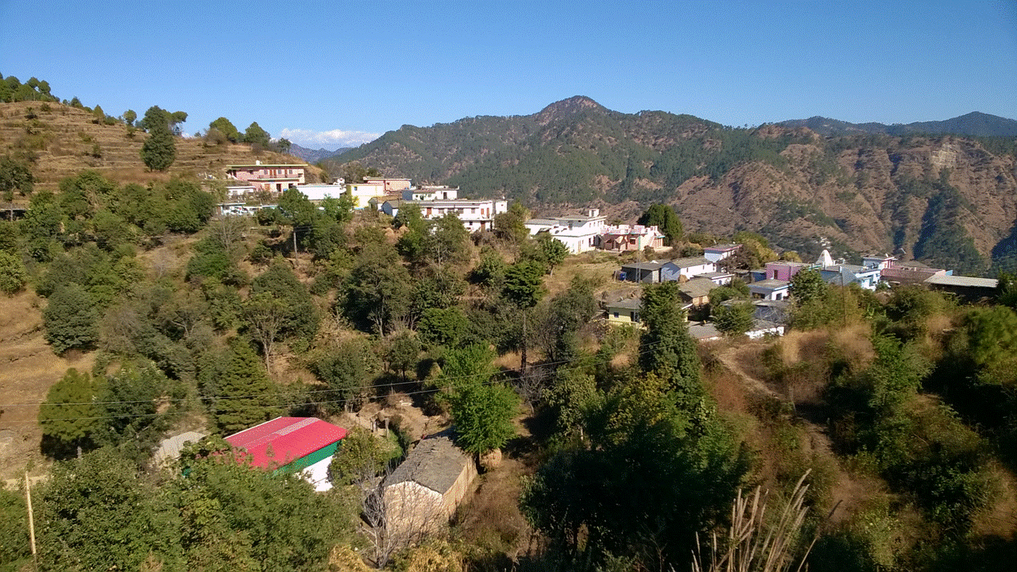
Notes:
The view from the top of the hill overlooking the schoolhouse (red roof) shows the Himalayas in the distance (those are snow capped mountains not clouds!). Nearest village is Devikhet (can be seen in picture)

Slide 7
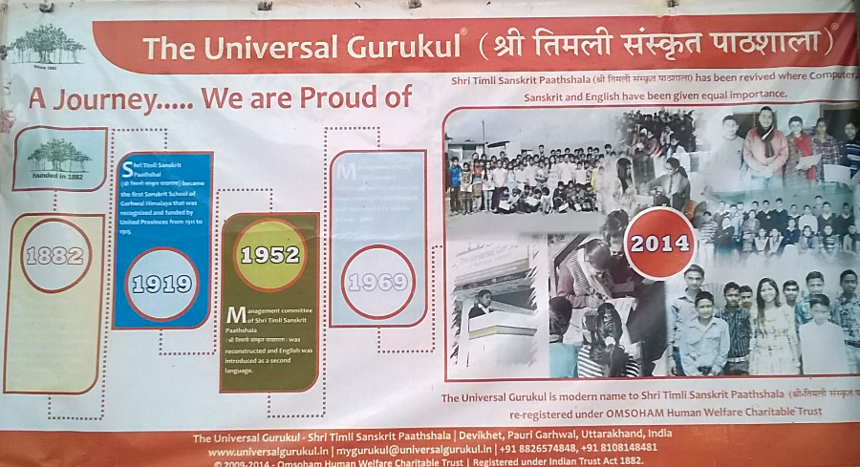
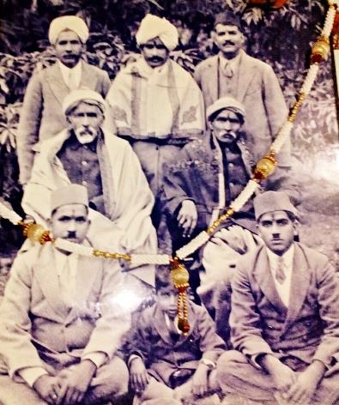
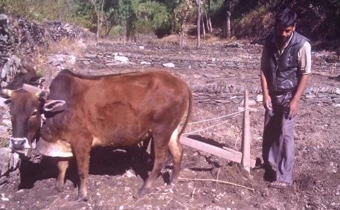
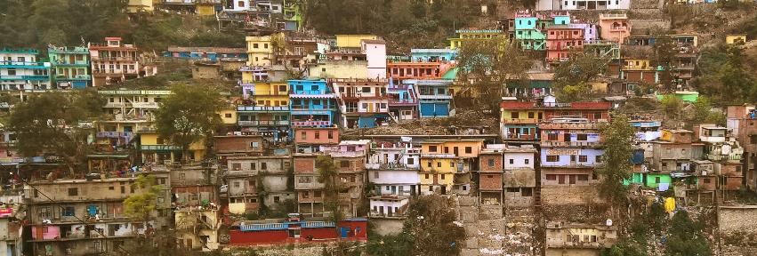
Notes:
Top Left: The Mainspring Timli School is part of a long tradition of schooling in this valley, dating back to 1882 when it was founded by Ashish Dabral’s Great Great Grandfather! (Top Right)
Bottom Left: Local farmer ploughing the fields at Timli Vidyapeeth Organic farms.
Bottom Right: A typical town of in Himalayas (Karnprayag).

Slide 8
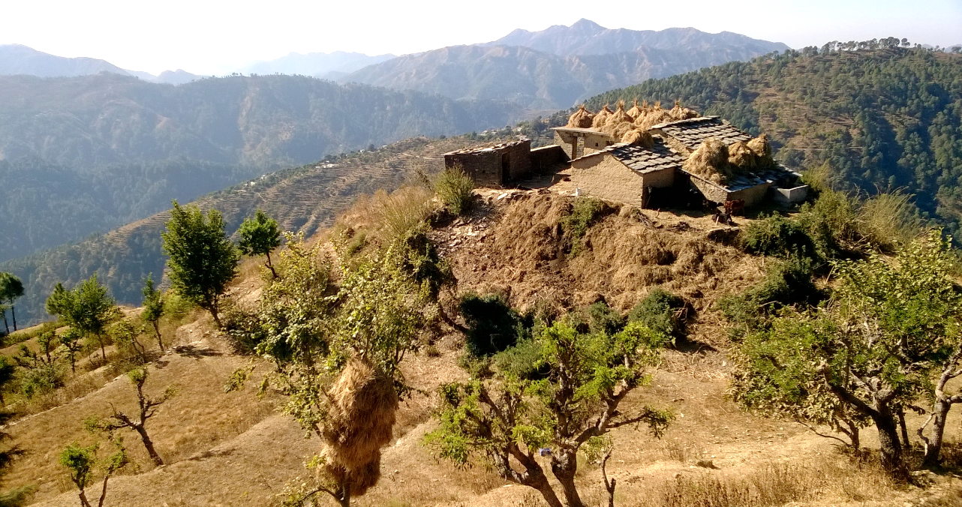
Notes:
The landscape is very mountainous and rural. Hay to feed goats and cows is harvested for times when grass is scarce. They stack it on the roof and up into trees to air dry!
There are many more techniques used by locals which is scientific and innovative. i.e. methods to preserve seeds, using water energy for grain grinding, using local plant’s fiber to make ropes, cots and many more…

Slide 9

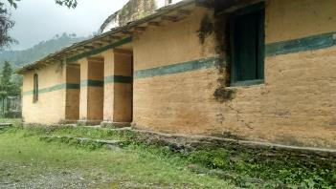
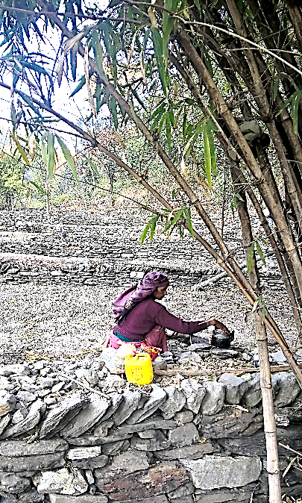
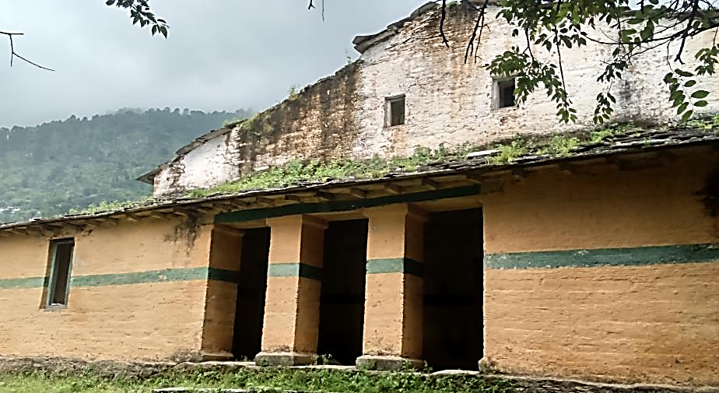
Notes:
Bottom Left : The old schoolhouse, built in 1952 to replace the original. This was Ashish Dabral’s school when he was a boy. Originally built in 1882.
Right : Village women working on Timli Vidyapeeth – Organic Farms (Students would learn farming techniques here)
Top Left: A view of Himalayan Mountains.
Top Middle: The old Schoolhouse.

Slide 10


Notes:
A BIG thank you for linking with us from all the children, parents and teachers at Mainspring Timli School.

