Slide 1

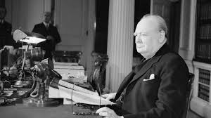
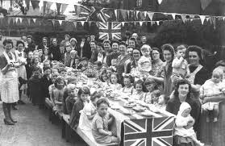
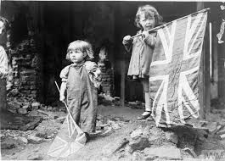
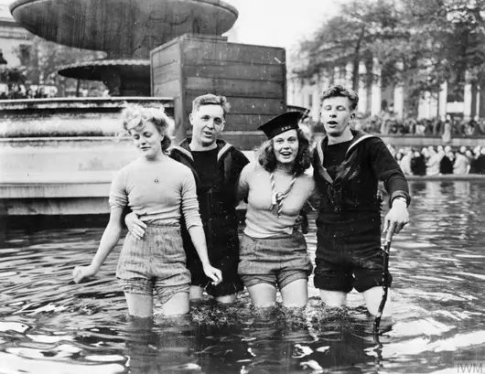

VE day celebrations
celebrations lasted for over 36 hours
Winston Churchill delivering a speech
Sailors celebrating in a fountain in the middle of London

